Slide 1

MANAGING NETWORKING CHAOS WHILE MIGRATING TO AWS MULTI-ACCOUNT ARCHITECTURE
Routing in multi-account setup
26th November 2020

Slide 2
ROUTING IN AWS MULTI-ACCOUNT
Agenda
About the presenter
Starting up with one account
Scaling up to few accounts
Further scaling to hundreds of accounts
Expanding to cross-region
2020 / brainly.com
Notes:
In case you see it too small - pin the presentation and use full screen

Slide 3

WELCOME
Krzysztof Szyper
Senior Infrastructure Engineer at Brainly
Using AWS since 2012
Everything-as-Code enthusiast
https://shyper.pro
2020 / brainly.com
Notes:
Senior Infra Engineer AWS since 2012 Everything-as-Code

Slide 4
All-to-all routing
3 AZs per VPC, only 4 VPCs per region, only 2 regions
Just some basic connections
Only IPv4
Split tunnel VPN, 8h/day/user
Not calculating data transfer costs
Cloud networks at 10.0.0.0/9, Corporate networks at 10.128.0.0/9
Simplified setup
2020 / brainly.com
Notes:
Hope for no mistake in calculations All-to-all routing, basic connections, only IPv4, not showing data costs
From private/startup to enterprise. Not about Brainly 8h/day for user => $12

Slide 5
How do we start?
Let’s begin with one VPC
2020 / brainly.com
Notes:
One VPC

Slide 6
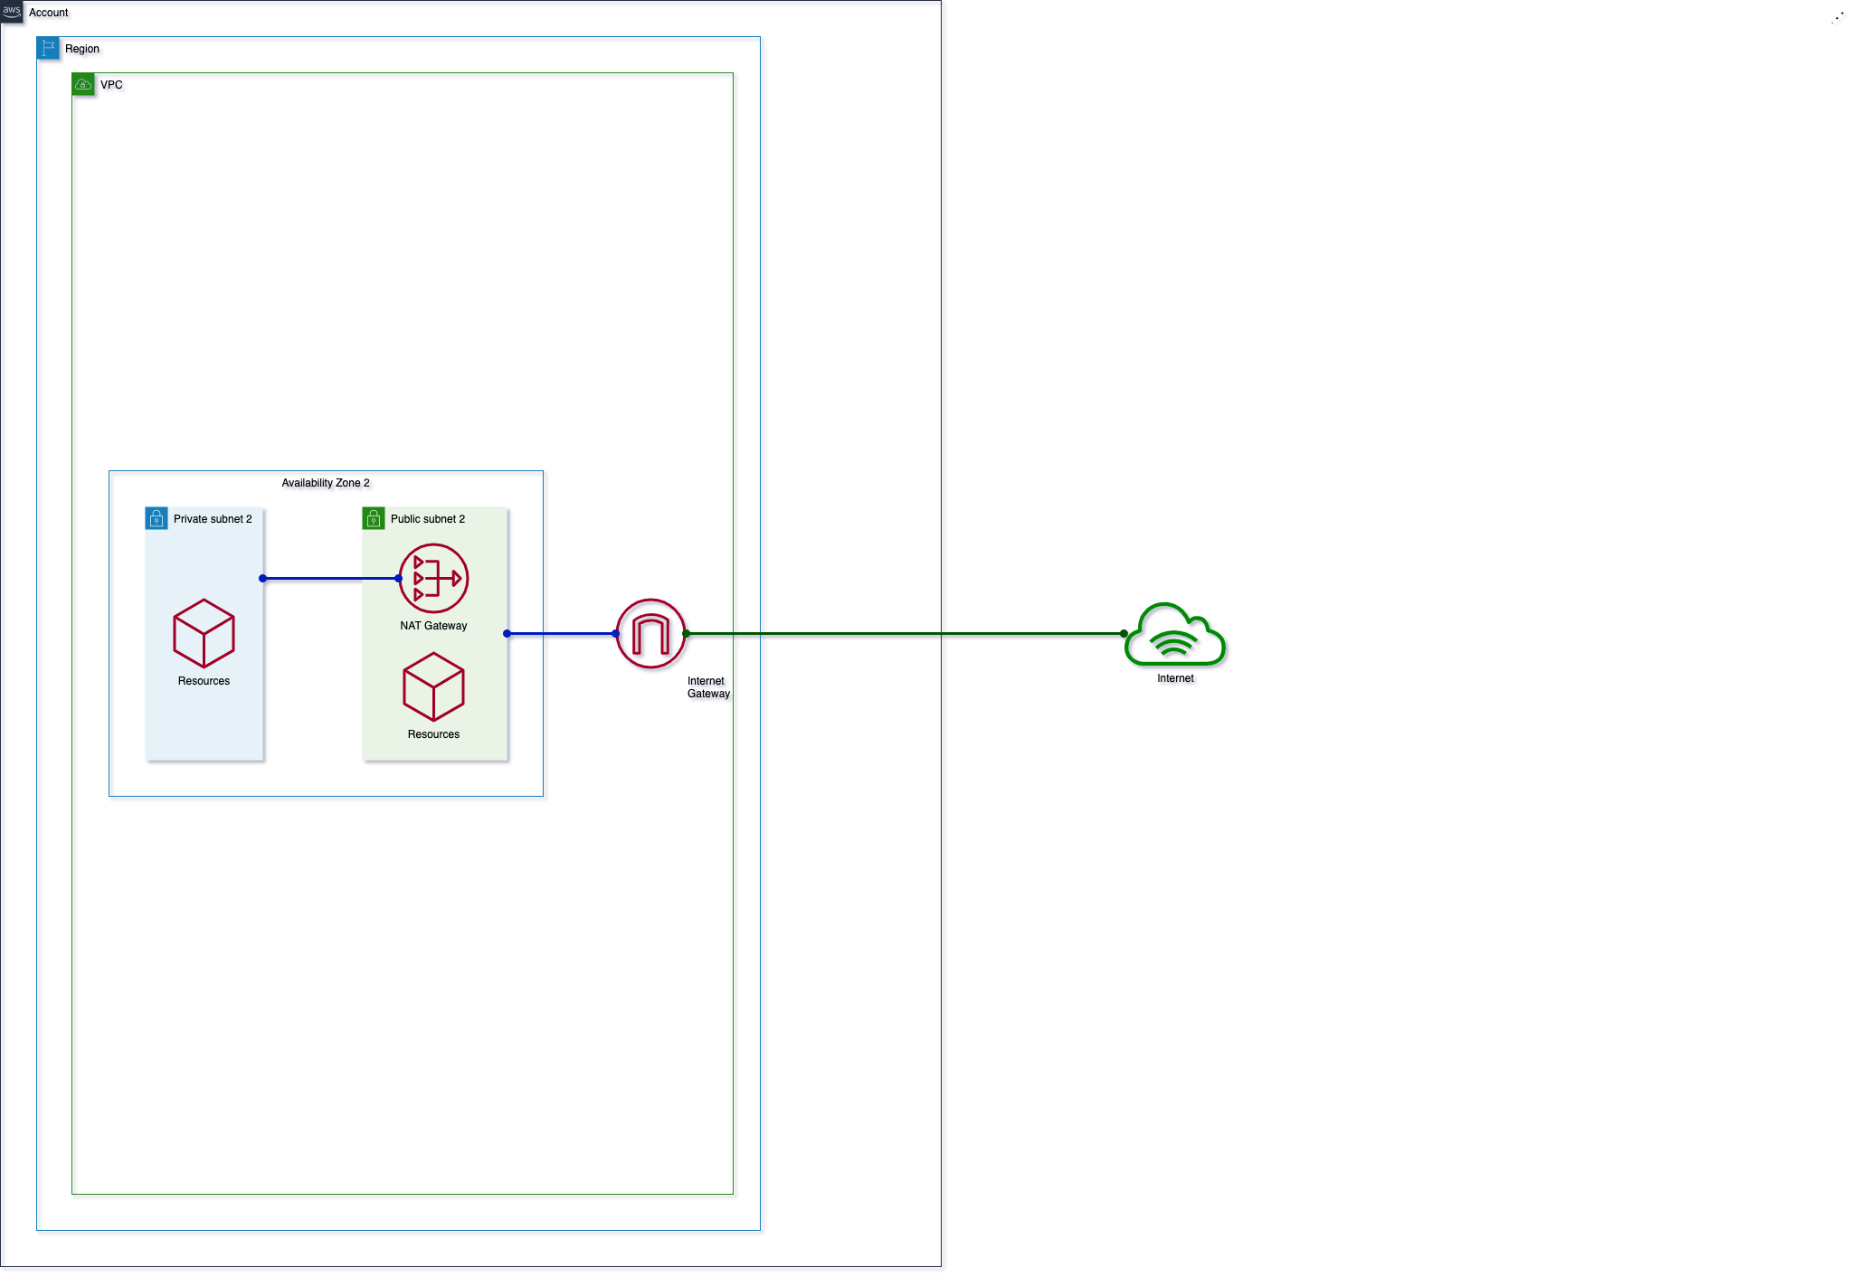
Destination | Private | Public | VPE
10.0.0.0/16 (VPC) | Local | Local | -
0.0.0.0/0 | nat-1a… | igw-1... | -
Resources | Costs
NAT GW | $35 + data
IGW | data
VPE | -
VGW | -
Sum: | $35 + data
2020 / brainly.com
Notes:
Create 1 zone Abstract of routing and simplified costs +$35 / 21 resources

Slide 7
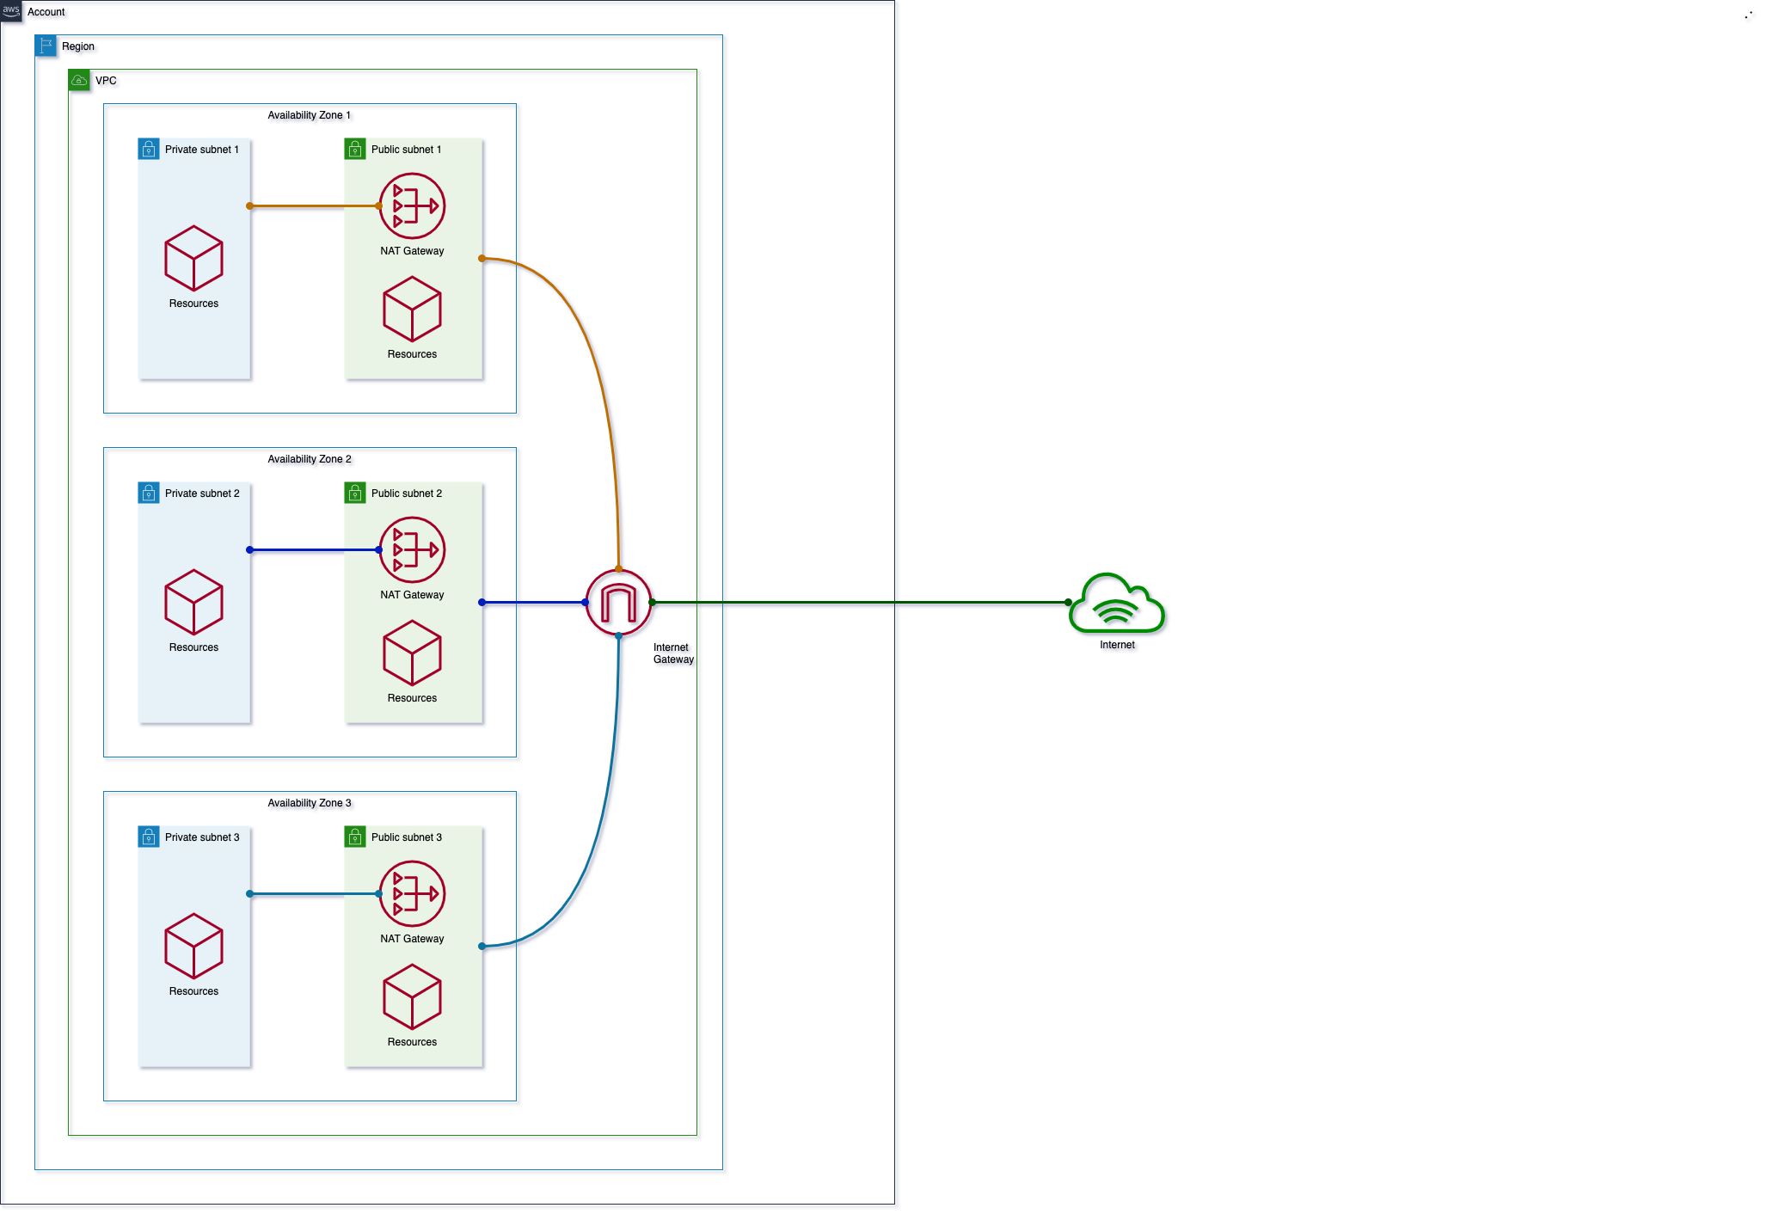
Destination | Private | Public | VPE
10.0.0.0/16 (VPC) | Local | Local | -
0.0.0.0/0 | nat-1a… nat-1b… nat-1c… | igw-1... | -
Resources | Costs
NAT GW | $35 + data + $70
IGW | data
VPE | -
VGW | -
Sum: | $105 + data
2020 / brainly.com
Notes:
Add 2 zones +$70 / +15 resources (36)

Slide 8
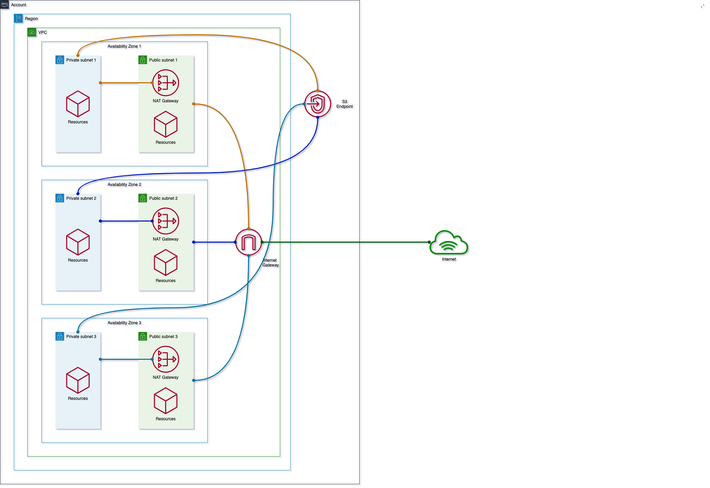
Destination | Private | Public | VPE
10.0.0.0/16 (VPC) | Local | Local | -
0.0.0.0/0 | nat-1a… nat-1b… nat-1c... | igw-1... | -
pl-1a… (S3) | vpc-1a... | - | -
Resources | Costs
NAT GW | $105 + data
IGW | data
VPE | -
VGW | -
Sum: | $105 + data
2020 / brainly.com
Notes:
Add S3 VPC Endpoint 1 EP, 3 routes Savings, +4 resources (40)

Slide 9
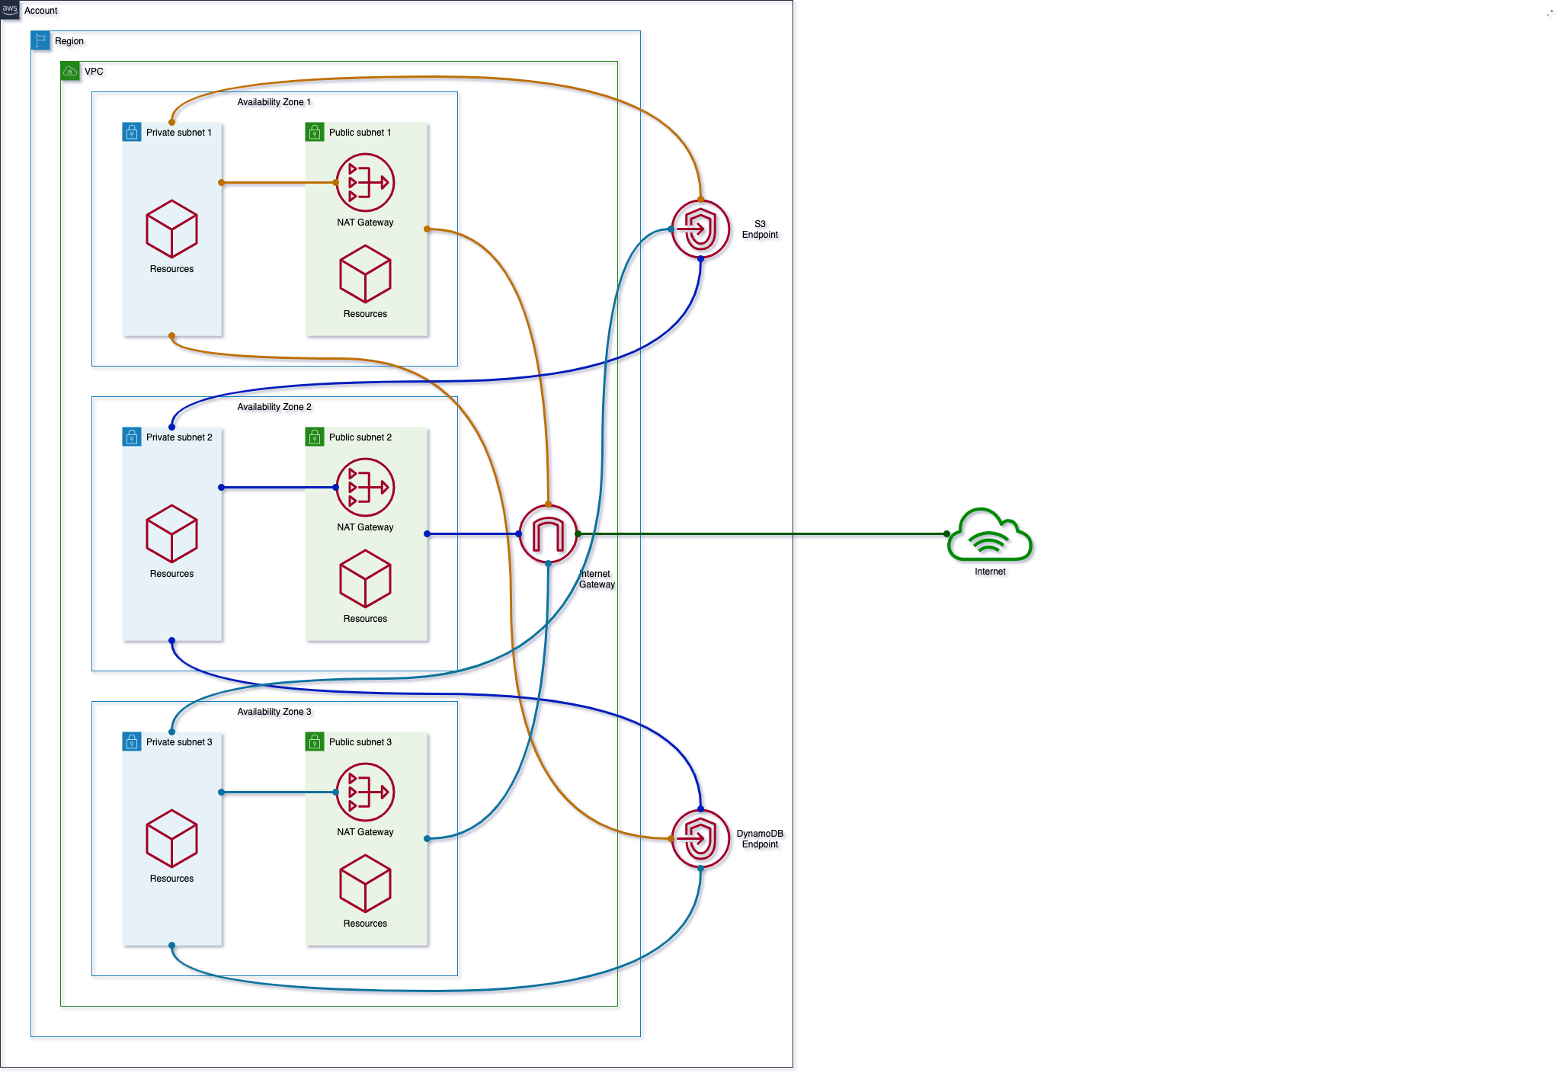
Destination | Private | Public | VPE
10.0.0.0/16 (VPC) | Local | Local | -
0.0.0.0/0 | nat-1a… nat-1b… nat-1c... | igw-1... | -
pl-1a… (S3) | vpc-1a... | - | -
pl-1b… (DynDB) | vpc-1b... | - | -
Resources | Costs
NAT GW | $105 + data
IGW | data
VPE | -
VGW | -
Sum: | $105 + data
2020 / brainly.com
Notes:
Add DynamoDB VPC Endpoint 1 EP, 3 routes, Savings, +4 resources (40)

Slide 10
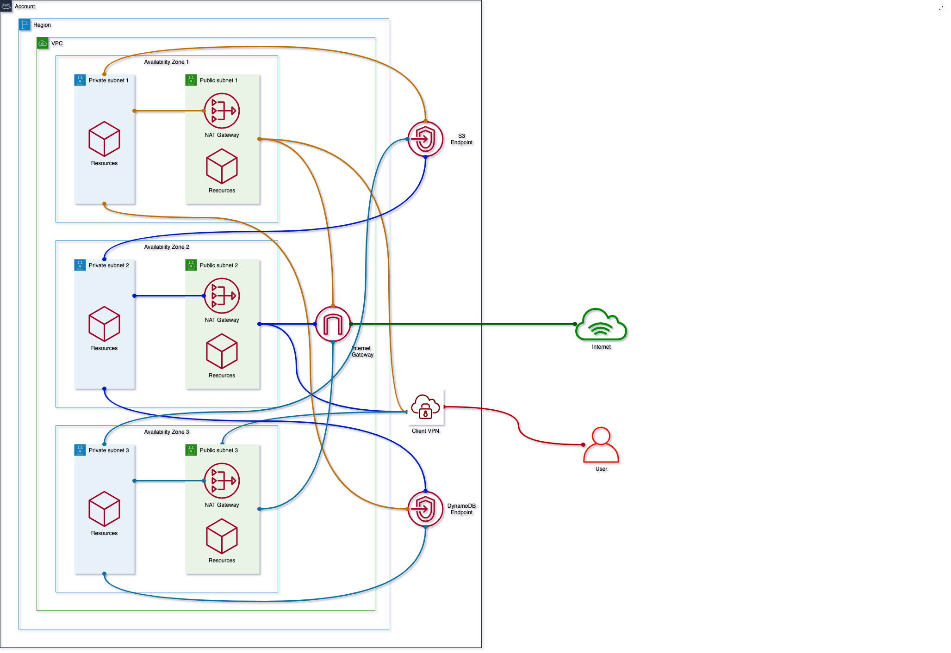
Destination | Private | Public | VPE
10.0.0.0/16 (VPC) | Local | Local | subnet-1a subnet-1b subnet-1c
0.0.0.0/0 | nat-1a… nat-1b… nat-1c... | igw-1... | -
pl-1a… (S3) | vpc-1a... | - | -
pl-1b… (DynDB) | vpc-1b... | - | -
169.254.169.252 /30 (AWS) | - | - | subnet-1a subnet-1b subnet-1c
Resources | Costs
NAT GW | $105 + data
IGW | data
VPE | $36 + $219 (assoc) + $12 (user)
VGW | -
Sum: | $360 + $12/user + data
2020 / brainly.com
Notes:
Add Client VPN Endpoint 1 VPN EP, 6 routes, 3 ass. +$255 ($219 for 6 assoc.), +10 resources (54)
+$12/user

Slide 11
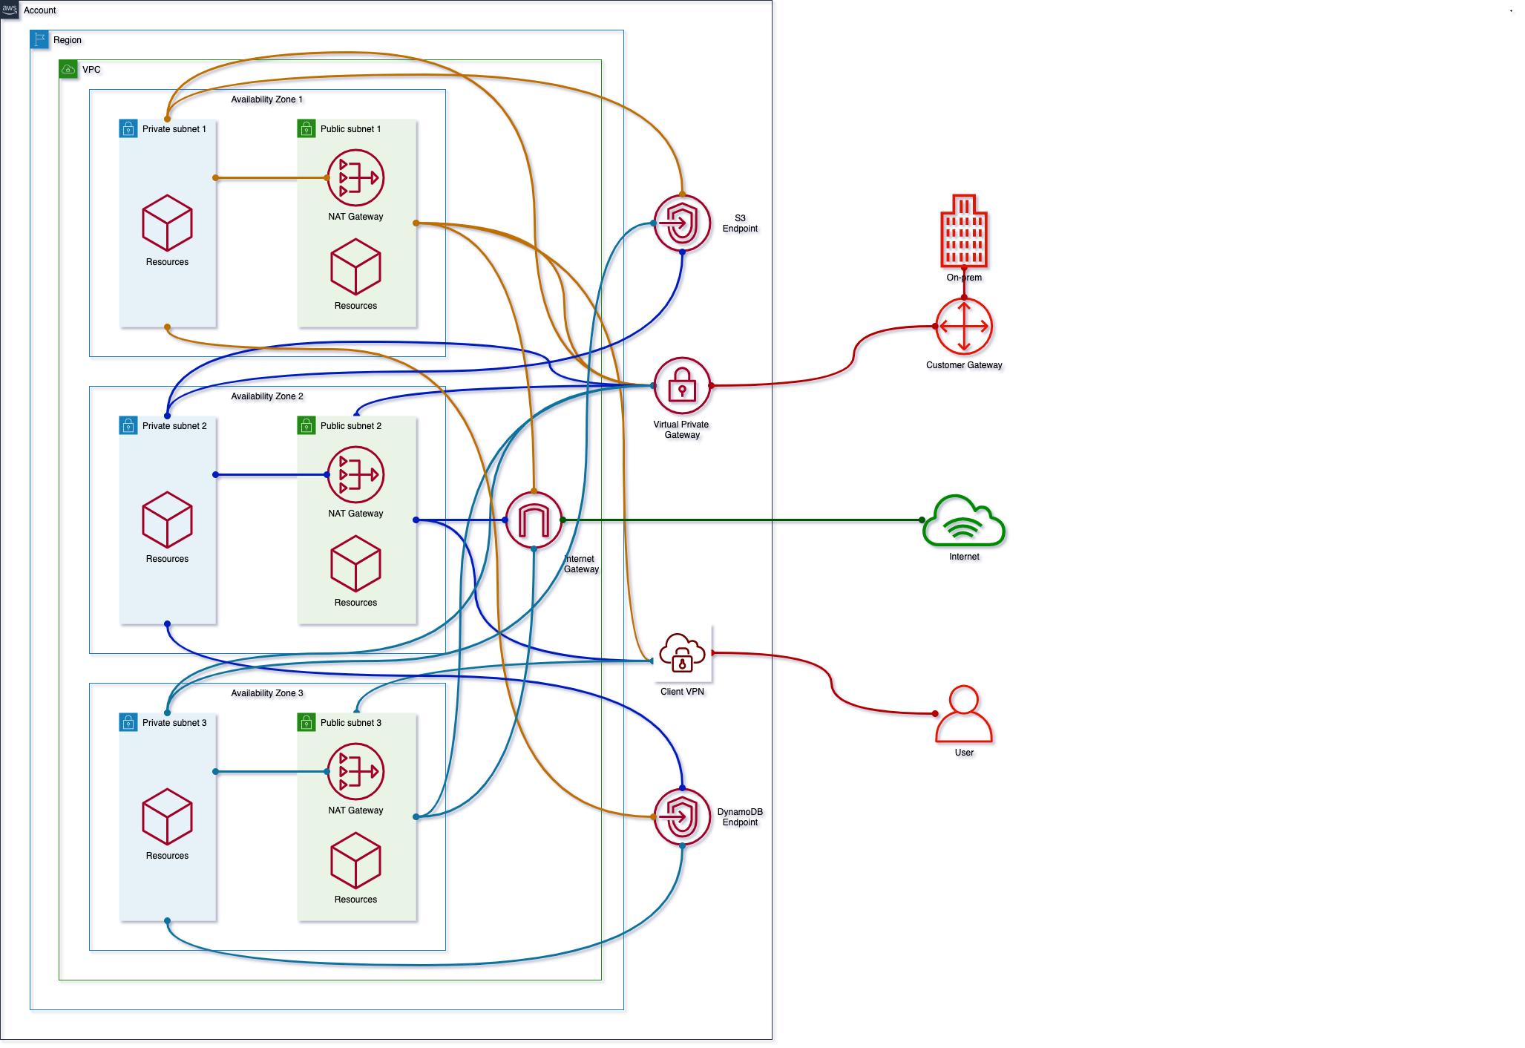
Destination | Private | Public | VPE
10.0.0.0/16 (VPC) | Local | Local | subnet-1a subnet-1b subnet-1c
0.0.0.0/0 | nat-1a… nat-1b… nat-1c... | igw-1... | -
pl-1a… (S3) | vpc-1a... | - | -
pl-1b… (DynDB) | vpc-1b... | - | -
169.254.169.252 /30 (AWS) | - | - | subnet-1a subnet-1b subnet-1c
10.128.0.0/9 (Corp) | vgw-1... | vgw-1... | subnet-1a subnet-1b subnet-1c
Resources | Costs
NAT GW | $105 + data
IGW | data
VPE | $255 + $12 (user)
VGW | $36
Sum: | $396 + $12/user + data
2020 / brainly.com
Notes:
Add Private Gateway 2 GW, 3 routes, 5 ass. +$36, +14 resources (68)

Slide 12
How can we expand?
Now add few more VPCs and peer them
2020 / brainly.com
Notes:
Add more VPCs

Slide 13
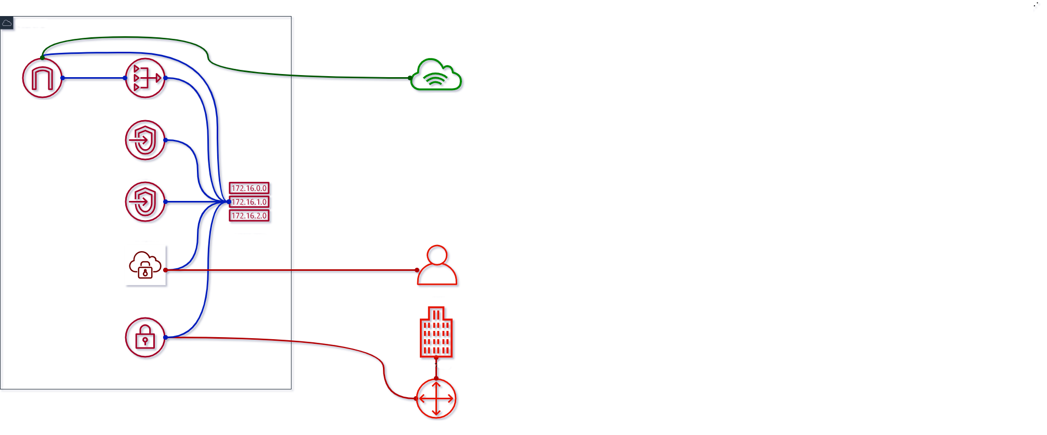
Destination | Private | Public | VPE
10.0.0.0/16 (VPC) | Local | Local | subnet-1a/b/c
0.0.0.0/0 | nat-1a/b/c... | igw-1... | -
pl-1a… (S3) | vpc-1a... | - | -
pl-1b… (DynDB) | vpc-1b... | - | -
169.254.169.252 /30 (AWS) | - | - | subnet-1a/b/c
10.128.0.0/9 (Corp) | vgw-1... | vgw-1... | subnet-1a/b/c
Resources | Costs
NAT GW | $105 + data
IGW | data
VPE | $255 + $12 (user)
VGW | $36
Sum: | $396 + $12/user + data
2020 / brainly.com
Notes:
1 VPC

Slide 14
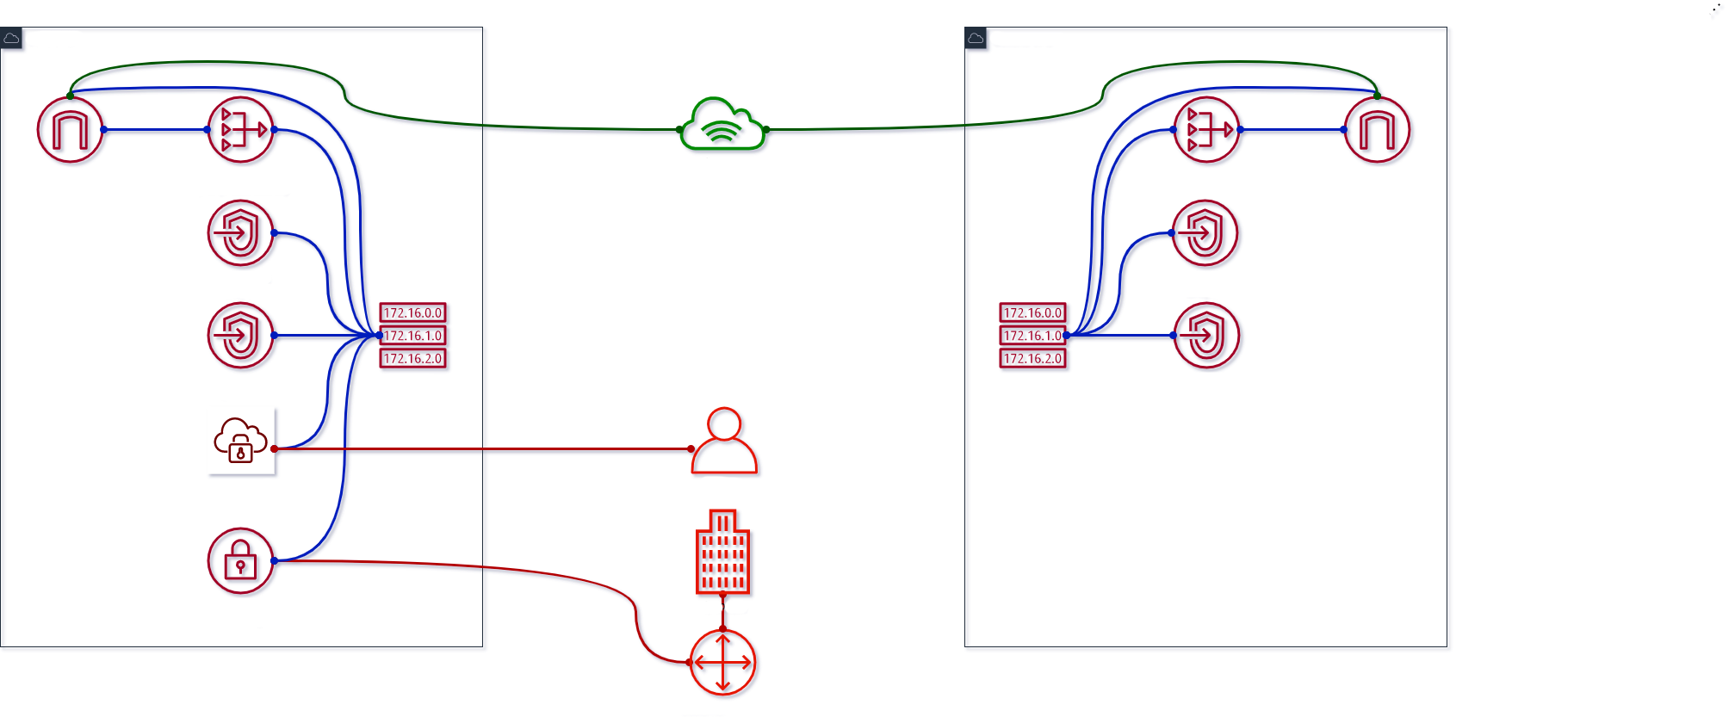
Destination | Private | Public | VPE
10.0.0.0/16 (VPC1) 10.1.0.0/16 (VPC2) | Local | Local | subnet-1a/b/c
0.0.0.0/0 | nat-1a/b/c… nat-2a/b/c… | igw-1… igw-2… | -
pl-… (S3) | vpc-1a... vpc-2a... | - | -
pl-… (DynDB) | vpc-1b… vpc-2b... | - | -
169.254.169.252 /30 (AWS) | - | - | subnet-1a/b/c
10.128.0.0/9 (Corp) | vgw-1… | vgw-1… | subnet-1a/b/c
Resources | Costs
NAT GW | $105 + data + $105
IGW | data
VPE | $255 + $12 (user)
VGW | $36
Sum: | $501 + $12/user + data
2020 / brainly.com
Notes:
2nd VPC
+$105 for NAT

Slide 15
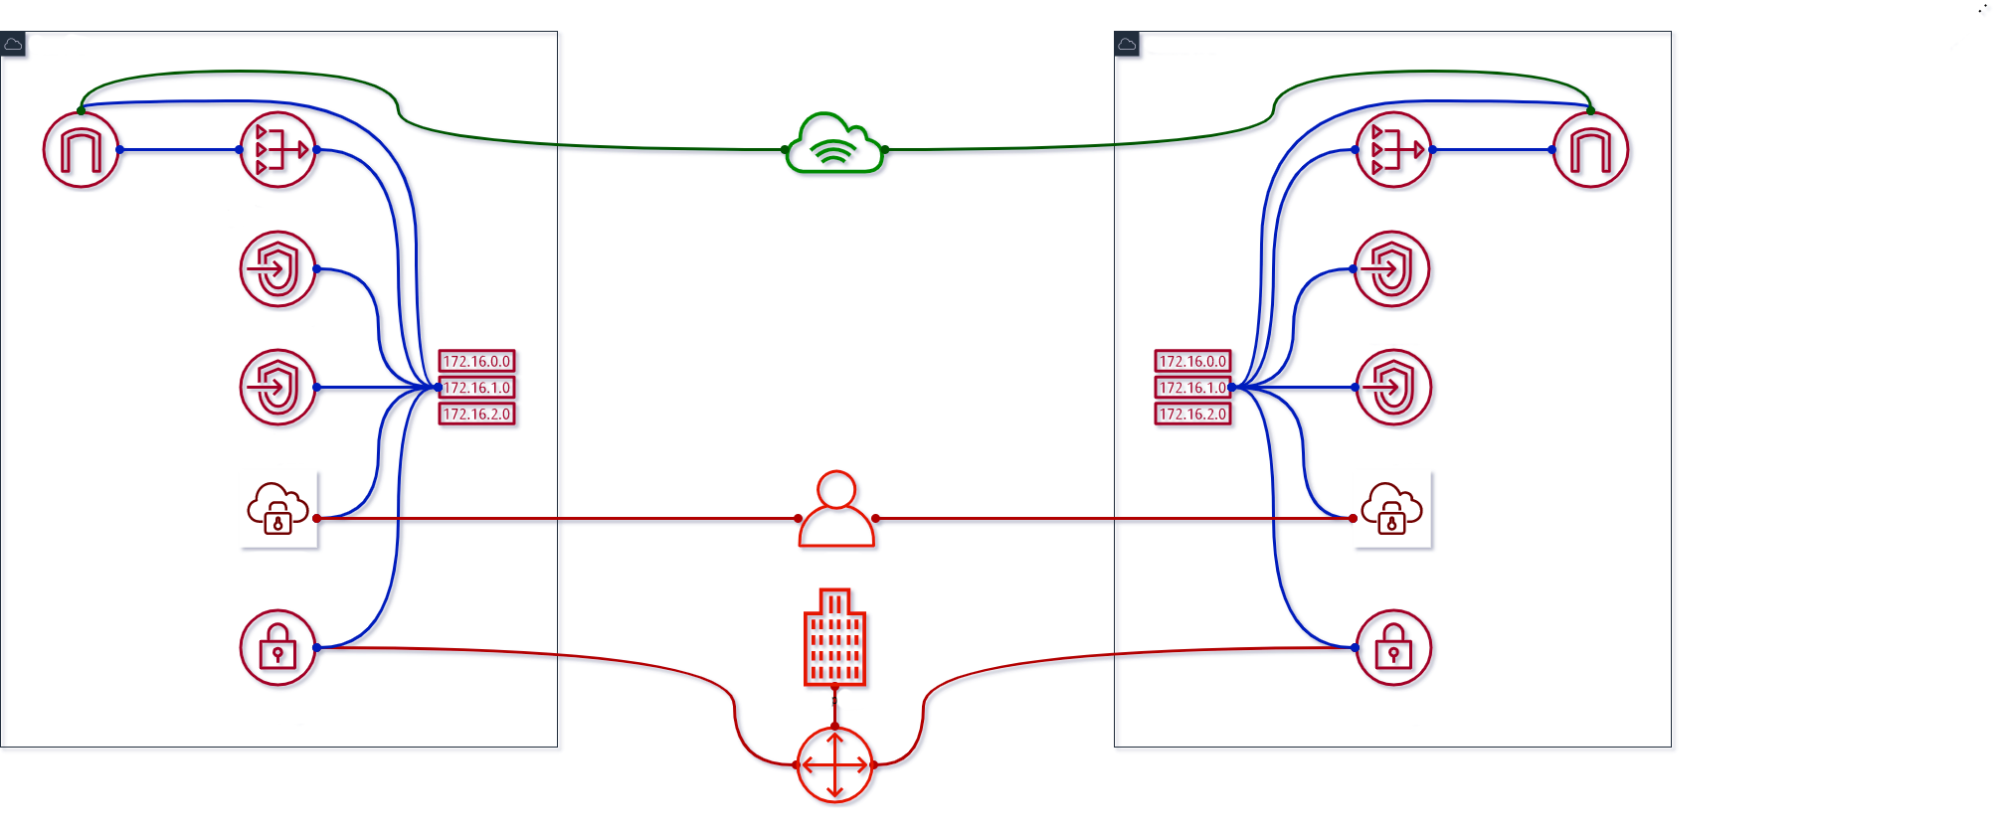
Destination | Private | Public | VPE
10.0.0.0/16 (VPC1) 10.1.0.0/16 (VPC2) | Local | Local | subnet-1a/b/c subnet-2a/b/c
0.0.0.0/0 | nat-1a/b/c… nat-2a/b/c… | igw-1… igw-2… | -
pl-… (S3) | vpc-1a... vpc-2a... | - | -
pl-… (DynDB) | vpc-1b… vpc-2b... | - | -
169.254.169.252 /30 (AWS) | - | - | subnet-1a/b/c subnet-2a/b/c
10.128.0.0/9 (Corp) | vgw-1… vgw-2... | vgw-1… vgw-2... | subnet-1a/b/c subnet-2a/b/c
Resources | Costs
NAT GW | $210 + data
IGW | data
VPE | $255 + $12 (user) + $255
VGW | $36 + $36
Sum: | $792 + $12/user + data
2020 / brainly.com
Notes:
Add Client VPN and Virtual Gateway $255 for VPE assoc and $36 for VGW

Slide 16
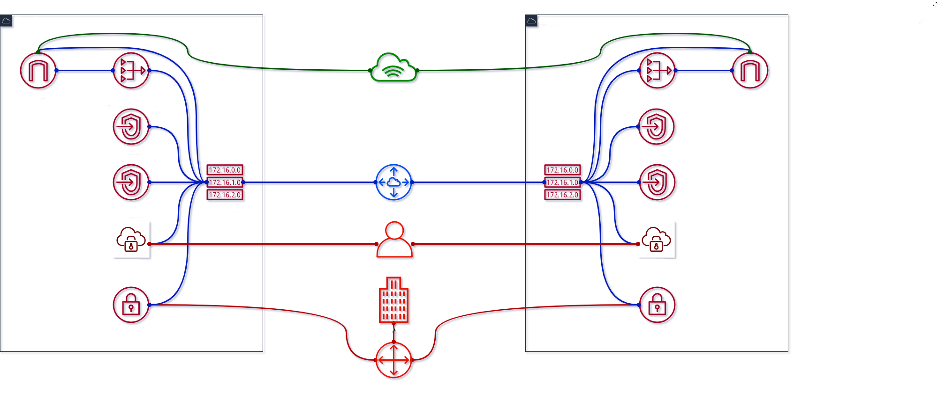
Destination | Private | Public | VPE
10.0.0.0/16 (VPC1) 10.1.0.0/16 (VPC2) | Local | Local | subnet-1a/b/c subnet-2a/b/c
0.0.0.0/0 | nat-1a/b/c… nat-2a/b/c… | igw-1… igw-2… | -
pl-… (S3) | vpc-1a... vpc-2a... | - | -
pl-… (DynDB) | vpc-1b… vpc-2b... | - | -
169.254.169.252 /30 (AWS) | - | - | subnet-1a/b/c subnet-2a/b/c
10.128.0.0/9 (Corp) | vgw-1… vgw-2... | vgw-1… vgw-2... | subnet-1a/b/c subnet-2a/b/c
10.0.0.0/16 (VPC1) | pcx-2... | pcx-2... | -
10.1.0.0/16 (VPC2) | pcx-1... | pcx-1... | -
Resources | Costs
NAT GW | $210 + data
IGW | data
VPE | $510 + $12 (user)
VGW | $72
Sum: | $792 + $12/user + data
2020 / brainly.com
Notes:
Add 1 peering

Slide 17
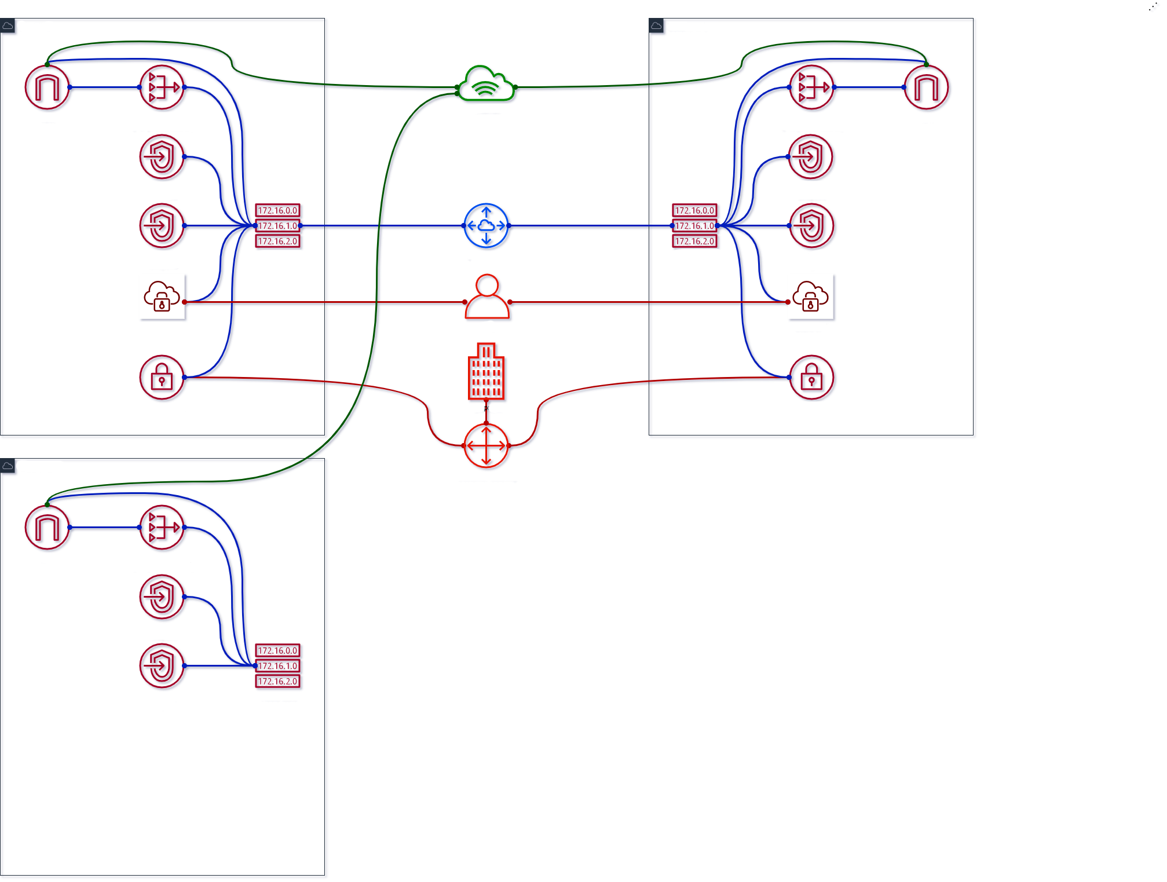
Destination | Private | Public | VPE
10.0.0.0/16 (VPC1) 10.1.0.0/16 (VPC2) 10.2.0.0/16 (VPC3) | Local | Local | subnet-1a/b/c subnet-2a/b/c
0.0.0.0/0 | nat-1a/b/c… nat-2a/b/c… nat-3a/b/c… | igw-1… igw-2… igw-3… | -
pl-… (S3) | vpc-1a/2a/3a... | - | -
pl-… (DynDB) | vpc-1b/2b/3b... | - | -
169.254.169.252 /30 (AWS) | - | - | subnet-1a/b/c subnet-2a/b/c
10.128.0.0/9 (Corp) | vgw-1… vgw-2... | vgw-1… vgw-2... | subnet-1a/b/c subnet-2a/b/c
10.0.0.0/16 (VPC1) | pcx-2... | pcx-2... | -
10.1.0.0/16 (VPC2) | pcx-1... | pcx-1... | -
Resources | Costs
NAT GW | $210 + data + $105
IGW | data
VPE | $510 + $12 (user)
VGW | $72
Sum: | $897 + $12/user + data
2020 / brainly.com
Notes:
Add 3rd VPC, NAT GWs
$105 for NAT

Slide 18
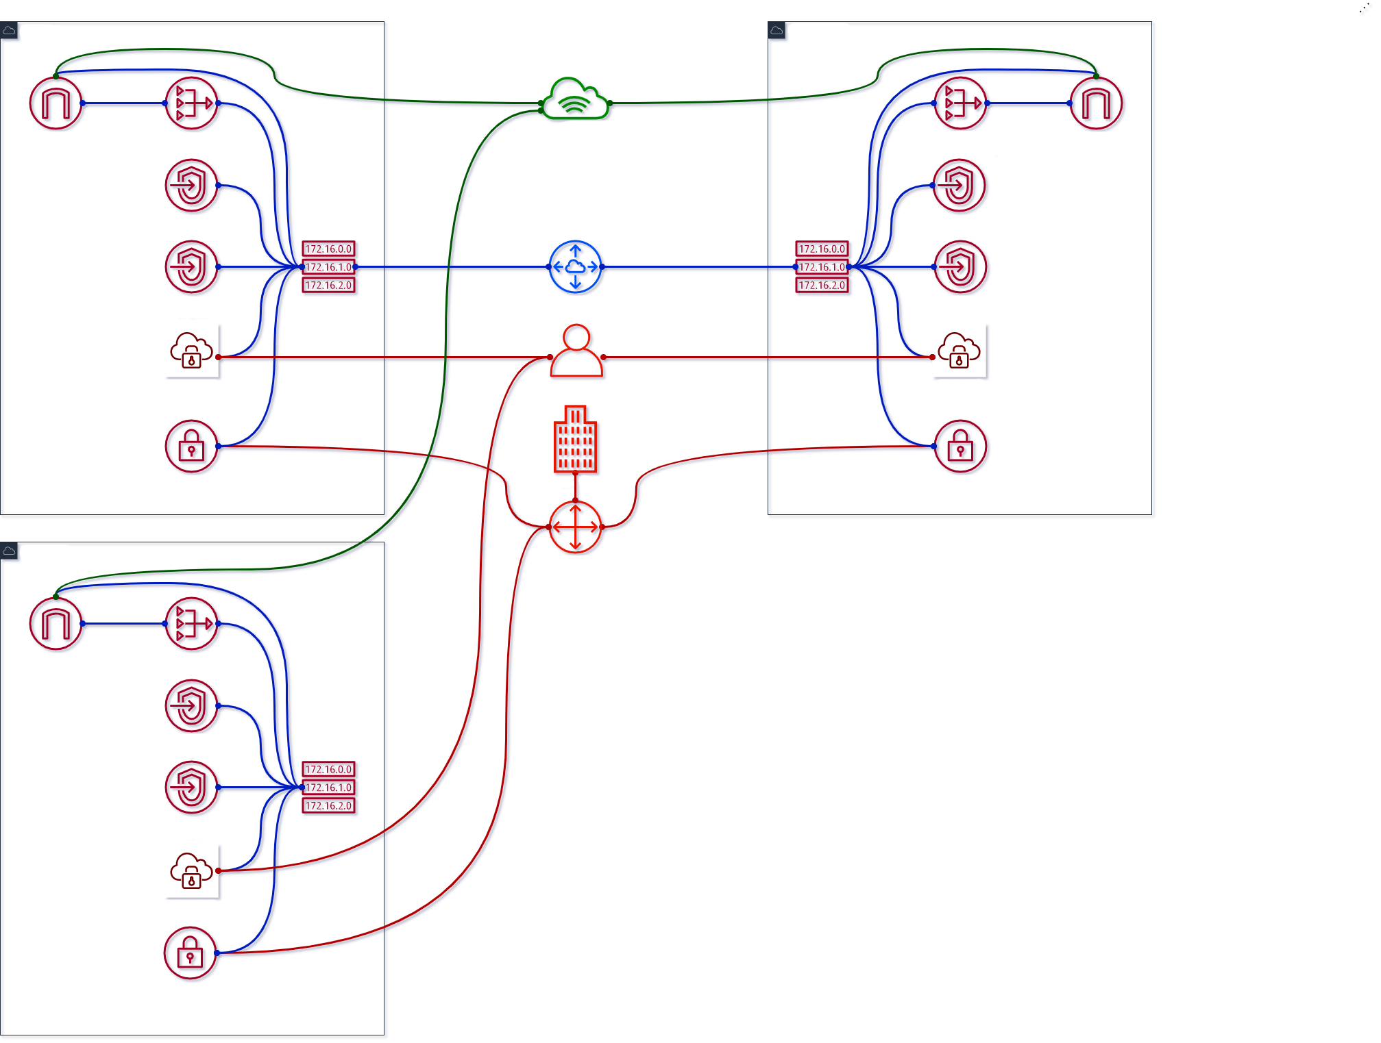
Destination | Private | Public | VPE
10.0.0.0/16 (VPC1) 10.1.0.0/16 (VPC2) 10.2.0.0/16 (VPC3) | Local | Local | subnet-1a/b/c subnet-2a/b/c subnet-3a/b/c
0.0.0.0/0 | nat-1a/b/c… nat-2a/b/c… nat-3a/b/c… | igw-1… igw-2… igw-3… | -
pl-… (S3) | vpc-1a/2a/3a... | - | -
pl-… (DynDB) | vpc-1b/2b/3b... | - | -
169.254.169.252 /30 (AWS) | - | - | subnet-1a/b/c subnet-2a/b/c subnet-3a/b/c
10.128.0.0/9 (Corp) | vgw-1… vgw-2… vgw-3... | vgw-1… vgw-2… vgw-3... | subnet-1a/b/c subnet-2a/b/c subnet-3a/b/c
10.0.0.0/16 (VPC1) | pcx-2... | pcx-2... | -
10.1.0.0/16 (VPC2) | pcx-1... | pcx-1... | -
Resources | Costs
NAT GW | $315 + data
IGW | data
VPE | $510 + $12 (user) + $255
VGW | $72 + $36
Sum: | $1188 + $12/user + data
2020 / brainly.com
Notes:
Add VPN for 3rd VPC $255 for VPE with assoc

Slide 19
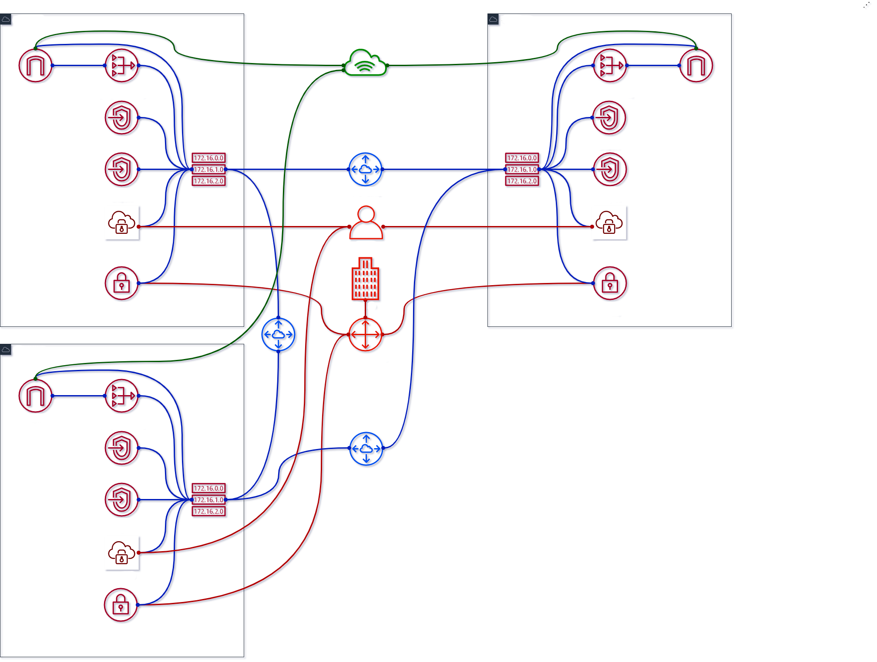
Destination | Private | Public | VPE
10.0.0.0/16 (VPC1) 10.1.0.0/16 (VPC2) 10.2.0.0/16 (VPC3) | Local | Local | subnet-1a/b/c subnet-2a/b/c subnet-3a/b/c
0.0.0.0/0 | nat-1a/b/c… nat-2a/b/c… nat-3a/b/c… | igw-1… igw-2… igw-3… | -
pl-… (S3) | vpc-1a/2a/3a... | - | -
pl-… (DynDB) | vpc-1b/2b/3b... | - | -
169.254.169.252 /30 (AWS) | - | - | subnet-1a/b/c subnet-2a/b/c subnet-3a/b/c
10.128.0.0/9 (Corp) | vgw-1… vgw-2… vgw-3... | vgw-1… vgw-2… vgw-3... | subnet-1a/b/c subnet-2a/b/c subnet-3a/b/c
10.0.0.0/16 (VPC1) | pcx-2/3... | pcx-2/3... | -
10.1.0.0/16 (VPC2) | pcx-1/3... | pcx-1/3... | -
10.2.0.0/16 (VPC3) | pcx-1/2... | pcx-1/2... | -
Resources | Costs
NAT GW | $315 + data
IGW | data
VPE | $765 + $12 (user)
VGW | $108
Sum: | $1188 + $12/user + data
2020 / brainly.com
Notes:
Add peering for 3rd VPC

Slide 20
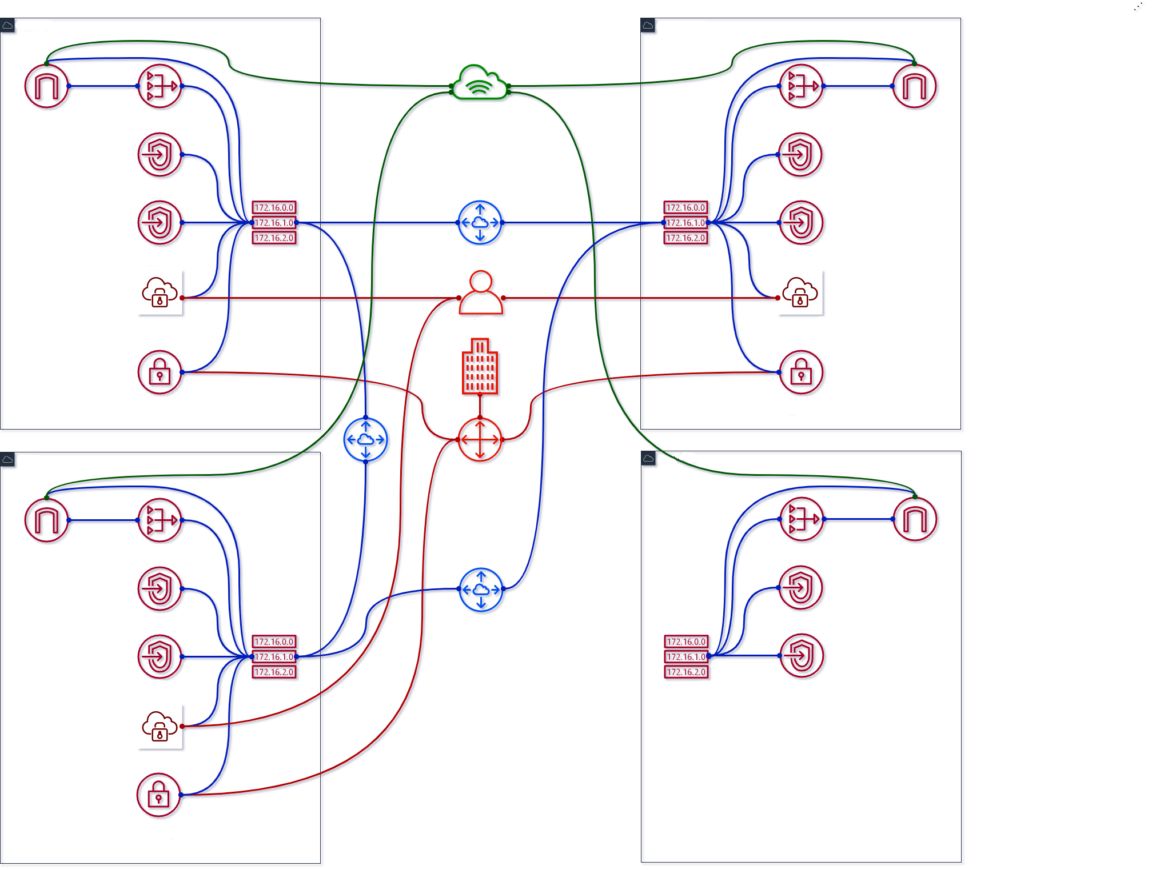
Destination | Private | Public | VPE
10.0.0.0/16 (VPC1) 10.1.0.0/16 (VPC2) 10.2.0.0/16 (VPC3) 10.3.0.0/16 (VPC4) | Local | Local | subnet-1a/b/c subnet-2a/b/c subnet-3a/b/c
0.0.0.0/0 | nat-1a/b/c… nat-2a/b/c… nat-3a/b/c… nat-4a/b/c… | igw-1… igw-2… igw-3… igw-4… | -
pl-… (S3) | vpc-1a/2a/3a/4a... | - | -
pl-… (DynDB) | vpc-1b/2b/3b/4b... | - | -
169.254.169.252 /30 (AWS) | - | - | subnet-1a/b/c subnet-2a/b/c subnet-3a/b/c
10.128.0.0/9 (Corp) | vgw-1… vgw-2… vgw-3... | vgw-1… vgw-2… vgw-3... | subnet-1a/b/c subnet-2a/b/c subnet-3a/b/c
10.0.0.0/16 (VPC1) | pcx-2/3... | pcx-2/3... | -
10.1.0.0/16 (VPC2) | pcx-1/3... | pcx-1/3... | -
10.2.0.0/16 (VPC3) | pcx-1/2... | pcx-1/2... | -
Resources | Costs
NAT GW | $315 + data + $105
IGW | data
VPE | $765 + $12 (user)
VGW | $108
Sum: | $1293 + $12/user + data
2020 / brainly.com
Notes:
Add 4th VPC
+$105 NAT

Slide 21
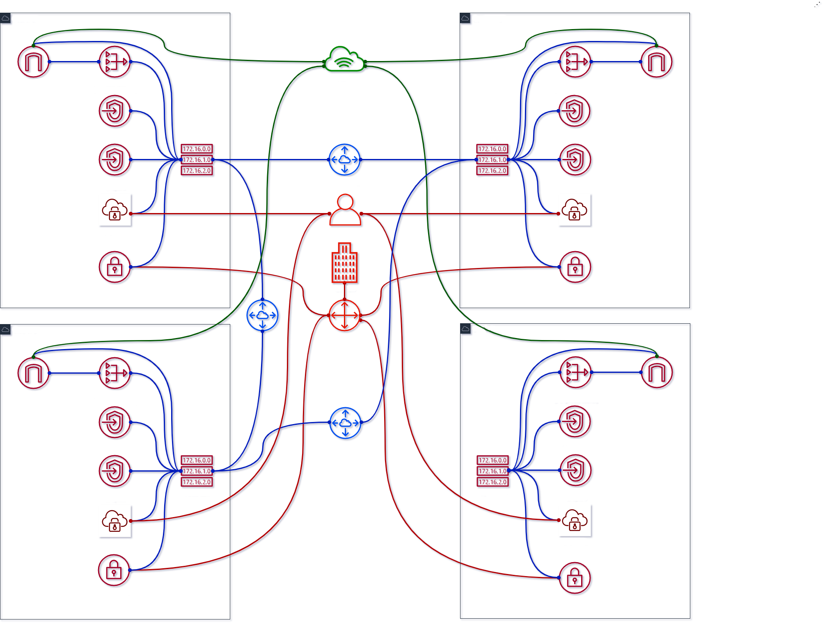
Destination | Private | Public | VPE
10.0.0.0/16 (VPC1) 10.1.0.0/16 (VPC2) 10.2.0.0/16 (VPC3) 10.3.0.0/16 (VPC4) | Local | Local | subnet-1a/b/c subnet-2a/b/c subnet-3a/b/c subnet-4a/b/c
0.0.0.0/0 | nat-1a/b/c… nat-2a/b/c… nat-3a/b/c… nat-4a/b/c… | igw-1… igw-2… igw-3… igw-4… | -
pl-… (S3) | vpc-1a/2a/3a/4a... | - | -
pl-… (DynDB) | vpc-1b/2b/3b/4b... | - | -
169.254.169.252 /30 (AWS) | - | - | subnet-1a/b/c subnet-2a/b/c subnet-3a/b/c subnet-4a/b/c
10.128.0.0/9 (Corp) | vgw-1… vgw-2… vgw-3… vgw-4... | vgw-1… vgw-2… vgw-3… vgw-4... | subnet-1a/b/c subnet-2a/b/c subnet-3a/b/c subnet-4a/b/c
10.0.0.0/16 (VPC1) | pcx-2/3... | pcx-2/3... | -
10.1.0.0/16 (VPC2) | pcx-1/3... | pcx-1/3... | -
10.2.0.0/16 (VPC3) | pcx-1/2... | pcx-1/2... | -
Resources | Costs
NAT GW | $420 + data
IGW | data
VPE | $765 + $12 (user) + $255
VGW | $108 + $36
Sum: | $1584 + $12/user + data
2020 / brainly.com
Notes:
Add VPN for 4th VPC
$255 for VPE + $36 for VGW

Slide 22
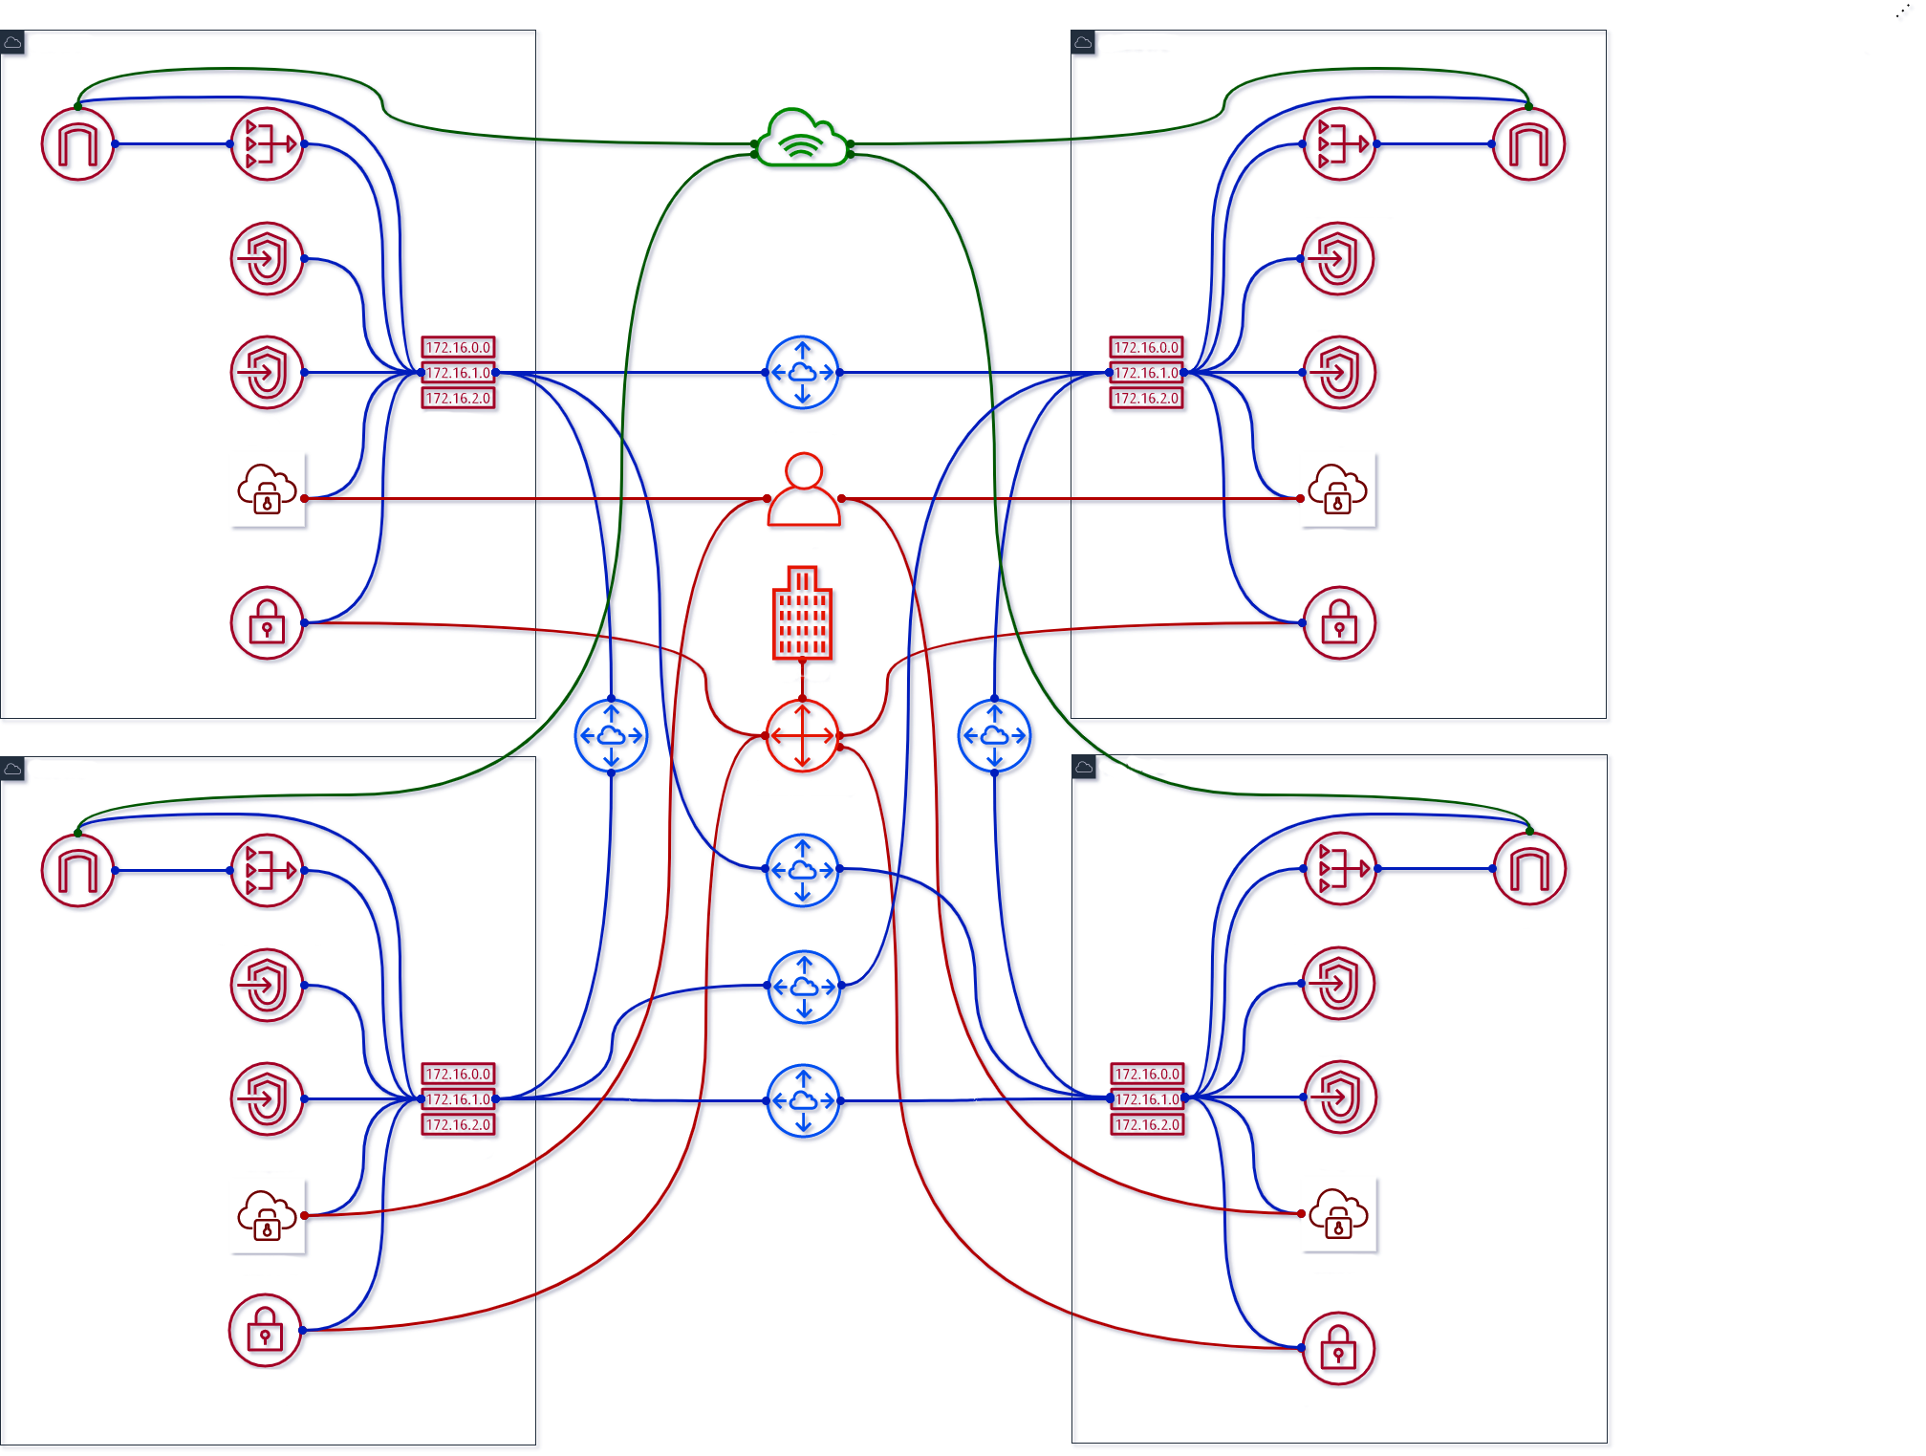
Destination | Private | Public | VPE
10.0.0.0/16 (VPC1) 10.1.0.0/16 (VPC2) 10.2.0.0/16 (VPC3) 10.3.0.0/16 (VPC4) | Local | Local | subnet-1a/b/c subnet-2a/b/c subnet-3a/b/c subnet-4a/b/c
0.0.0.0/0 | nat-1a/b/c… nat-2a/b/c… nat-3a/b/c… nat-4a/b/c… | igw-1… igw-2… igw-3… igw-4… | -
pl-… (S3) | vpc-1a/2a/3a/4a... | - | -
pl-… (DynDB) | vpc-1b/2b/3b/4b... | - | -
169.254.169.252 /30 (AWS) | - | - | subnet-1a/b/c subnet-2a/b/c subnet-3a/b/c subnet-4a/b/c
10.128.0.0/9 (Corp) | vgw-1… vgw-2… vgw-3… vgw-4... | vgw-1… vgw-2… vgw-3… vgw-4... | subnet-1a/b/c subnet-2a/b/c subnet-3a/b/c subnet-4a/b/c
10.0.0.0/16 (VPC1) | pcx-2/3/4... | pcx-2/3/4... | -
10.1.0.0/16 (VPC2) | pcx-1/3/4... | pcx-1/3/4... | -
10.2.0.0/16 (VPC3) | pcx-1/2/4... | pcx-1/2/4... | -
10.3.0.0/16 (VPC4) | pcx-1/2/3... | pcx-1/2/3... | -
Resources | Costs
NAT GW | $420 + data
IGW | data
VPE | $1020 + $12 (user)
VGW | $144
Sum: | $1584 + $12/user + data
2020 / brainly.com
Notes:
Add peering for 4th VPC
269 resources, $396 per each account, 9 (standard) max => $3564 Arithmetic sequence

Slide 23
Can we grow further?
Add even more VPCs with Transit Gateway
2020 / brainly.com

Slide 24
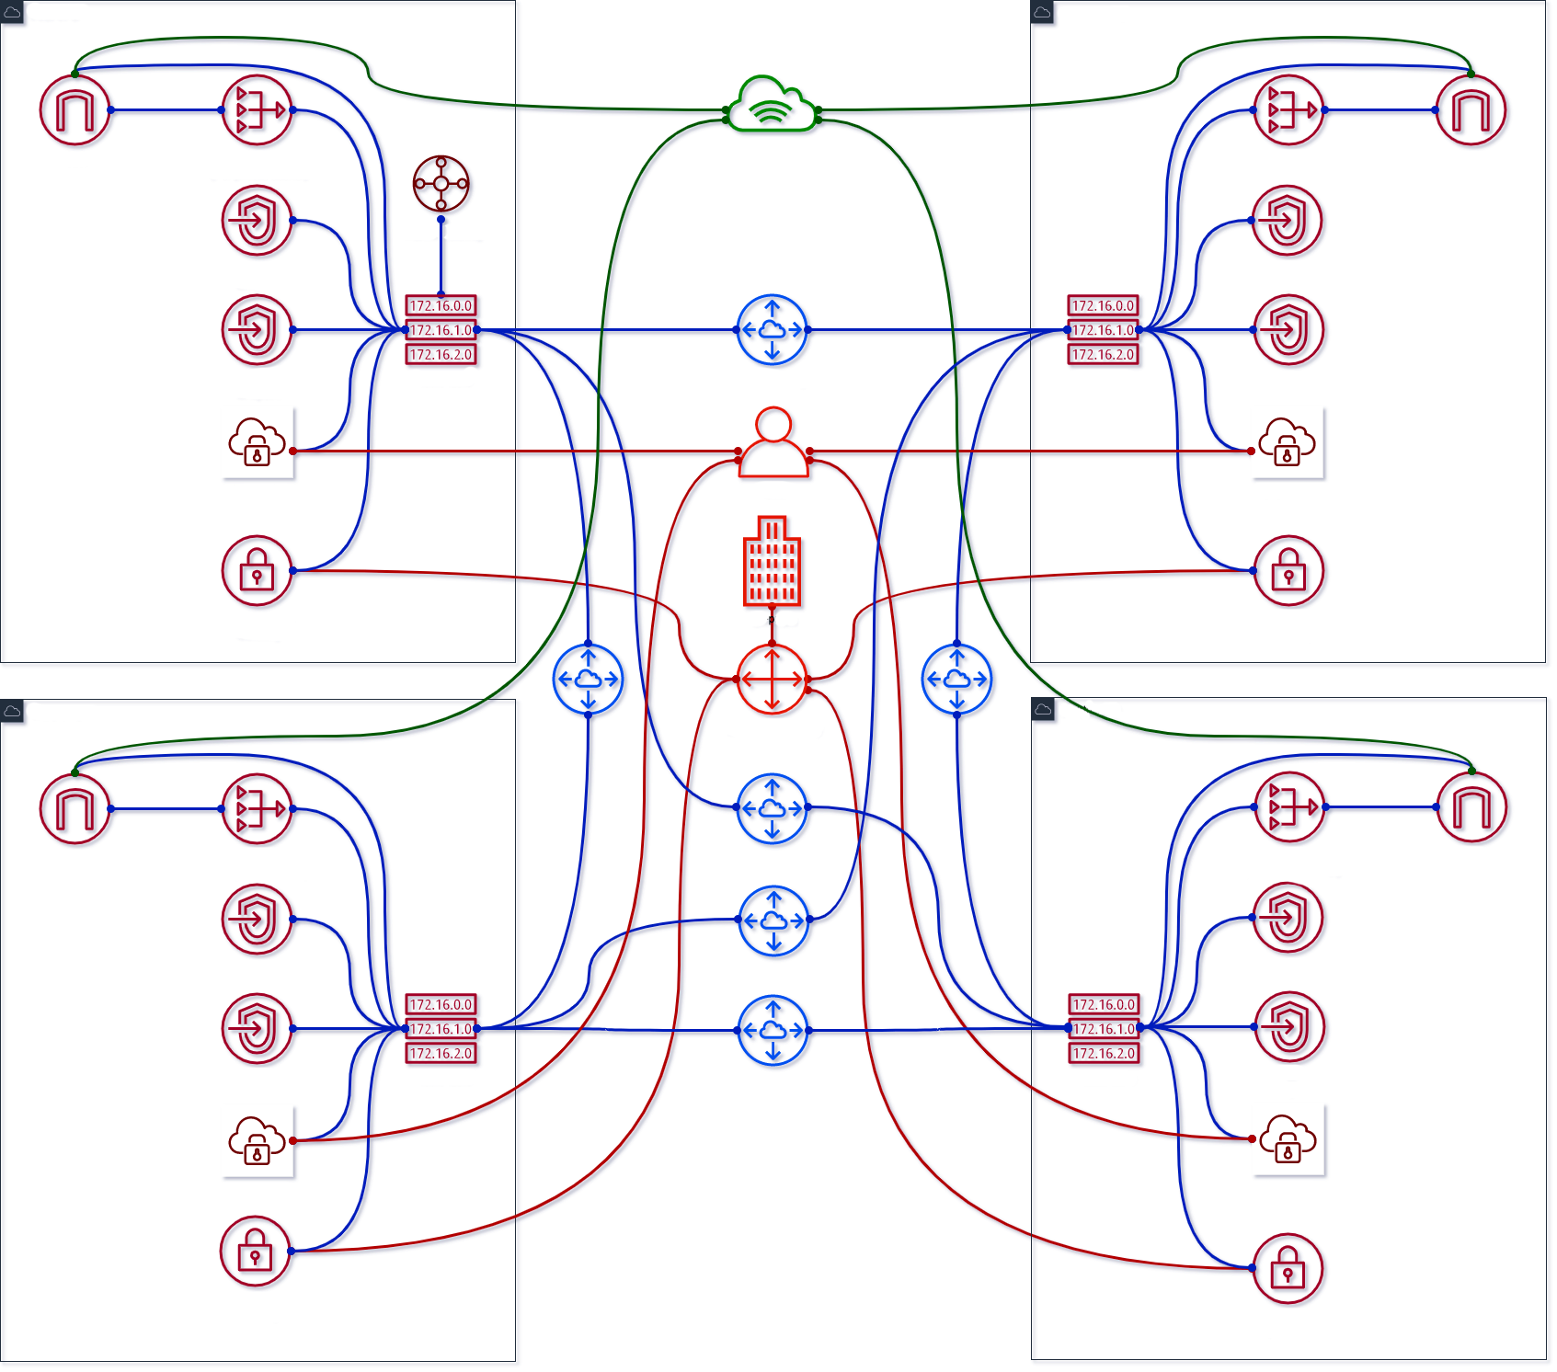
Destination | Private | Public | VPE
10.0.0.0/16 (VPC1) 10.1.0.0/16 (VPC2) 10.2.0.0/16 (VPC3) 10.3.0.0/16 (VPC4) | Local | Local | subnet-1a/b/c subnet-2a/b/c subnet-3a/b/c subnet-4a/b/c
0.0.0.0/0 | nat-1a/b/c… nat-2a/b/c… nat-3a/b/c… nat-4a/b/c… | igw-1… igw-2… igw-3… igw-4… | -
pl-… (S3) | vpc-1a/2a/3a/4a... | - | -
pl-… (DynDB) | vpc-1b/2b/3b/4b... | - | -
169.254.169.252 /30 (AWS) | - | - | subnet-1a/b/c subnet-2a/b/c subnet-3a/b/c subnet-4a/b/c
10.128.0.0/9 (Corp) | vgw-1… vgw-2… vgw-3… vgw-4... | vgw-1… vgw-2… vgw-3… vgw-4... | subnet-1a/b/c subnet-2a/b/c subnet-3a/b/c subnet-4a/b/c
10.0.0.0/16 (VPC1) | pcx-2/3/4... | pcx-2/3/4... | -
10.1.0.0/16 (VPC2) | pcx-1/3/4... | pcx-1/3/4... | -
10.2.0.0/16 (VPC3) | pcx-1/2/4... | pcx-1/2/4... | -
10.3.0.0/16 (VPC4) | pcx-1/2/3... | pcx-1/2/3... | -
10.0.0.0/9 (Cloud) | tgw-att-1... | tgw-att-1... | -
Resources | Costs
NAT GW | $420 + data
IGW | data
VPE | $1020 + $12 (user)
VGW | $144
TGW | $36 + data
Sum: | $1620 + $12/user + data
2020 / brainly.com
Notes:
Added TGW $0.05 per hour $0.02 per GB

Slide 25
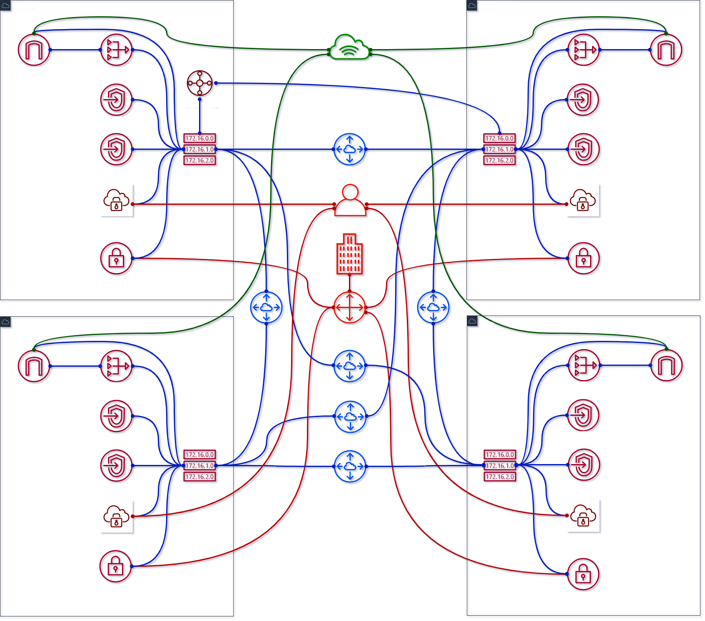
Destination | Private | Public | VPE
10.0.0.0/16 (VPC1) 10.1.0.0/16 (VPC2) 10.2.0.0/16 (VPC3) 10.3.0.0/16 (VPC4) | Local | Local | subnet-1a/b/c subnet-2a/b/c subnet-3a/b/c subnet-4a/b/c
0.0.0.0/0 | nat-1a/b/c… nat-2a/b/c… nat-3a/b/c… nat-4a/b/c… | igw-1… igw-2… igw-3… igw-4… | -
pl-… (S3) | vpc-1a/2a/3a/4a... | - | -
pl-… (DynDB) | vpc-1b/2b/3b/4b... | - | -
169.254.169.252 /30 (AWS) | - | - | subnet-1a/b/c subnet-2a/b/c subnet-3a/b/c subnet-4a/b/c
10.128.0.0/9 (Corp) | vgw-1… vgw-2… vgw-3… vgw-4... | vgw-1… vgw-2… vgw-3… vgw-4... | subnet-1a/b/c subnet-2a/b/c subnet-3a/b/c subnet-4a/b/c
10.0.0.0/16 (VPC1) | pcx-2/3/4… | pcx-2/3/4… | -
10.1.0.0/16 (VPC2) | pcx-1/3/4… | pcx-1/3/4… | -
10.2.0.0/16 (VPC3) | pcx-1/2/4... | pcx-1/2/4... | -
10.3.0.0/16 (VPC4) | pcx-1/2/3... | pcx-1/2/3... | -
10.0.0.0/9 (Cloud) | tgw-att-1/2... | tgw-att-1/2... | -
Resources | Costs
NAT GW | $420 + data
IGW | data
VPE | $1020 + $12 (user)
VGW | $144
TGW | $36 + data + $36
Sum: | $1656 + $12/user + data
2020 / brainly.com
Notes:
Added TGW ATTt for 2, Prepare to delete peering 1-2

Slide 26
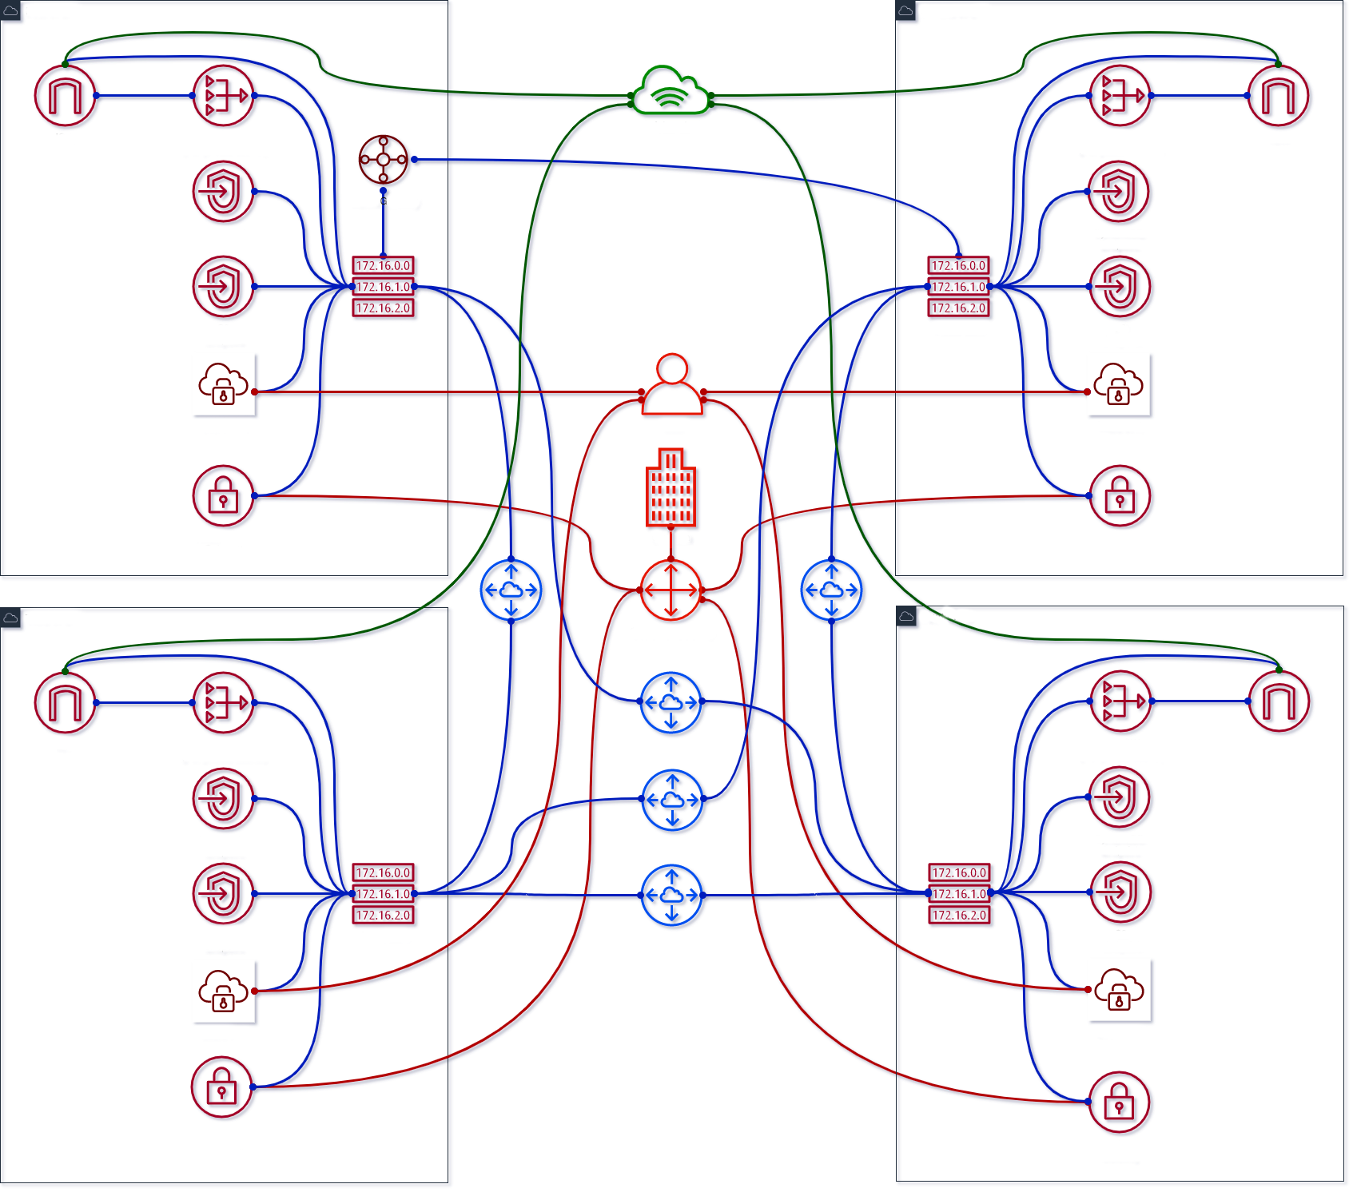
Destination | Private | Public | VPE
10.0.0.0/16 (VPC1) 10.1.0.0/16 (VPC2) 10.2.0.0/16 (VPC3) 10.3.0.0/16 (VPC4) | Local | Local | subnet-1a/b/c subnet-2a/b/c subnet-3a/b/c subnet-4a/b/c
0.0.0.0/0 | nat-1a/b/c… nat-2a/b/c… nat-3a/b/c… nat-4a/b/c… | igw-1… igw-2… igw-3… igw-4… | -
pl-… (S3) | vpc-1a/2a/3a/4a... | - | -
pl-… (DynDB) | vpc-1b/2b/3b/4b... | - | -
169.254.169.252 /30 (AWS) | - | - | subnet-1a/b/c subnet-2a/b/c subnet-3a/b/c subnet-4a/b/c
10.128.0.0/9 (Corp) | vgw-1… vgw-2… vgw-3… vgw-4… tgw-att-2... | vgw-1… vgw-2… vgw-3… vgw-4… tgw-att-2... | subnet-1a/b/c subnet-2a/b/c subnet-3a/b/c subnet-4a/b/c
10.0.0.0/16 (VPC1) | pcx-3/4… | pcx-3/4… | -
10.1.0.0/16 (VPC2) | pcx-3/4… | pcx-3/4… | -
10.2.0.0/16 (VPC3) | pcx-1/2/4... | pcx-1/2/4... | -
10.3.0.0/16 (VPC4) | pcx-1/2/3... | pcx-1/2/3... | -
10.0.0.0/9 (Cloud) | tgw-att-1/2... | tgw-att-1/2... | -
Resources | Costs
NAT GW | $420 + data
IGW | data
VPE | $1020 + $12 (user) - $255
VGW | $144 - $36
TGW | $72 + data
Sum: | $1656 + $12/user + data
2020 / brainly.com
Notes:
Removed peering 1-2
Prepare to remove VPNs for 2

Slide 27
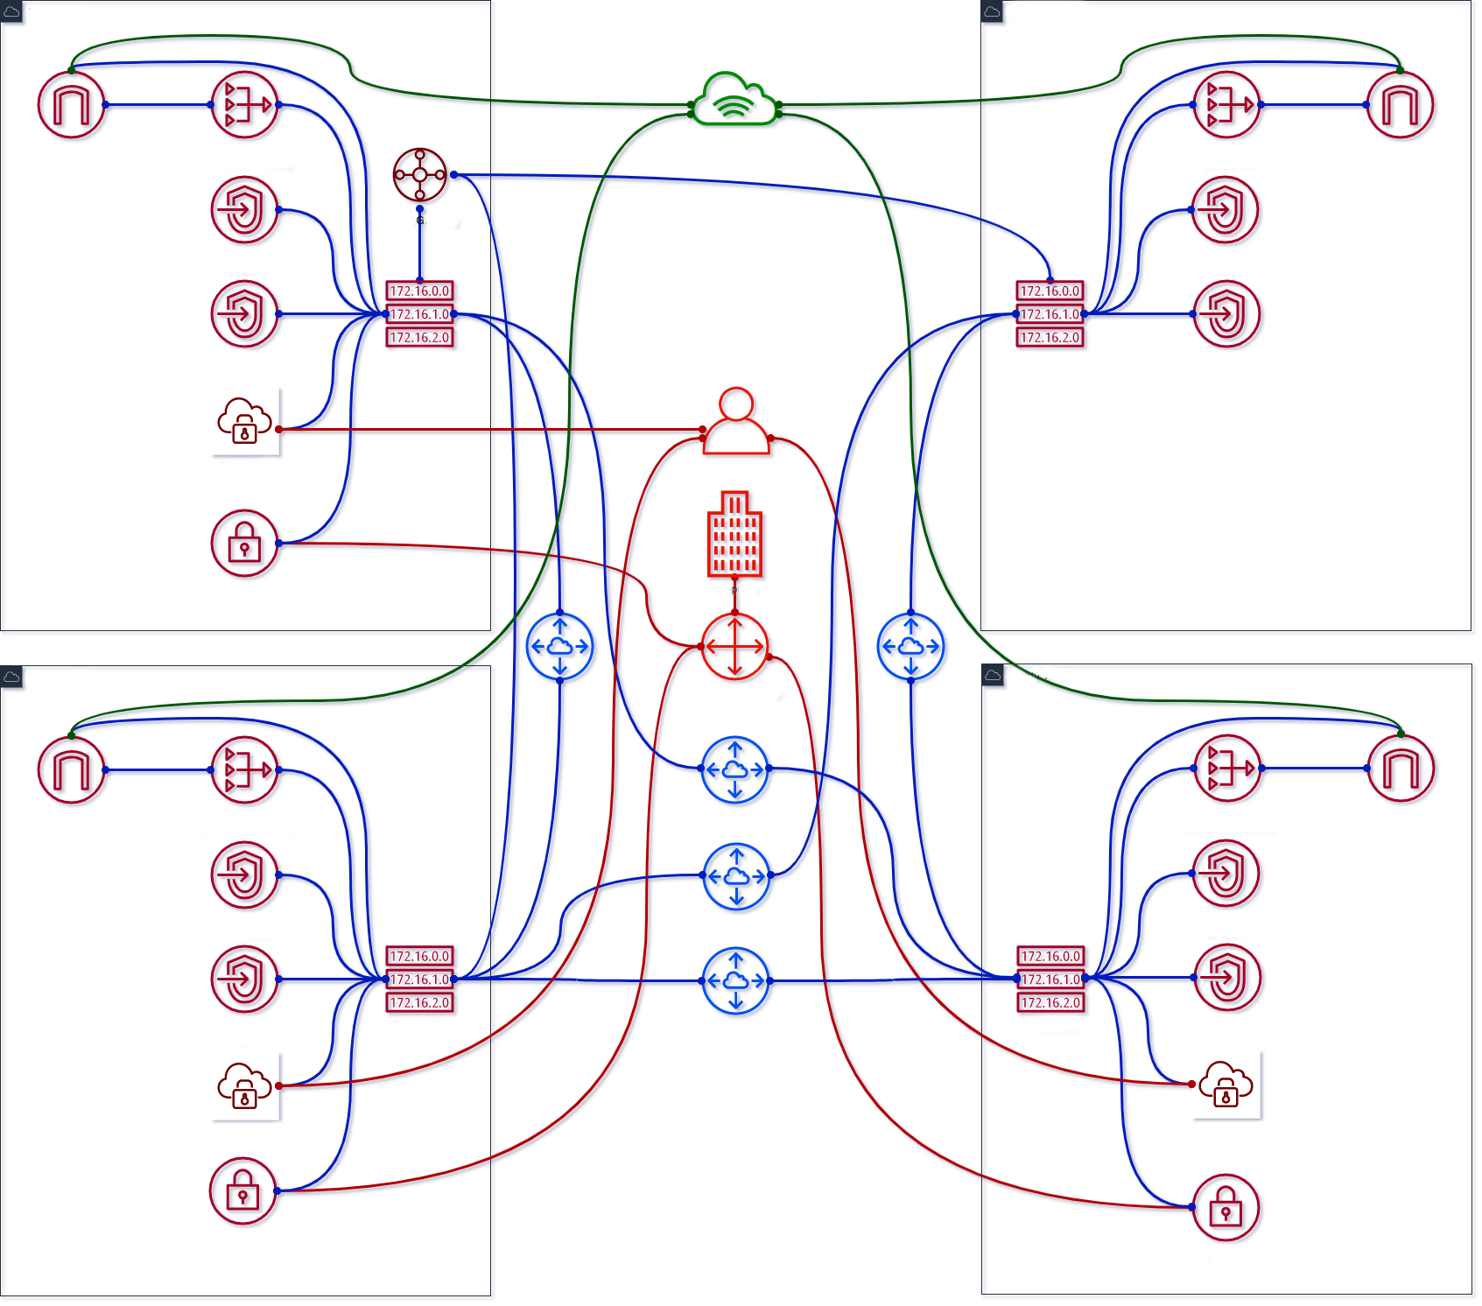
Destination | Private | Public | VPE
10.0.0.0/16 (VPC1) 10.1.0.0/16 (VPC2) 10.2.0.0/16 (VPC3) 10.3.0.0/16 (VPC4) | Local | Local | subnet-1a/b/c subnet-3a/b/c subnet-4a/b/c
0.0.0.0/0 | nat-1a/b/c… nat-2a/b/c… nat-3a/b/c… nat-4a/b/c… | igw-1… igw-2… igw-3… igw-4… | -
pl-… (S3) | vpc-1a/2a/3a/4a... | - | -
pl-… (DynDB) | vpc-1b/2b/3b/4b... | - | -
169.254.169.252 /30 (AWS) | - | - | subnet-1a/b/c subnet-3a/b/c subnet-4a/b/c
10.128.0.0/9 (Corp) | vgw-1… vgw-3… vgw-4… tgw-att-2... | vgw-1… vgw-3… vgw-4… tgw-att-2... | subnet-1a/b/c subnet-3a/b/c subnet-4a/b/c
10.0.0.0/16 (VPC1) | pcx-3/4… | pcx-3/4… | -
10.1.0.0/16 (VPC2) | pcx-3/4… | pcx-3/4… | -
10.2.0.0/16 (VPC3) | pcx-1/2/4… | pcx-1/2/4… | -
10.3.0.0/16 (VPC4) | pcx-1/2/3... | pcx-1/2/3... | -
10.0.0.0/9 (Cloud) | tgw-att-1/2/3... | tgw-att-1/2/3... | -
Resources | Costs
NAT GW | $420 + data
IGW | data
VPE | $765 + $12 (user)
VGW | $108
TGW | $72 + data + $36
Sum: | $1401 + $12/user + data
2020 / brainly.com
Notes:
Added TGW Att for 3
Prepare to remove peering 1-3, 2-3

Slide 28
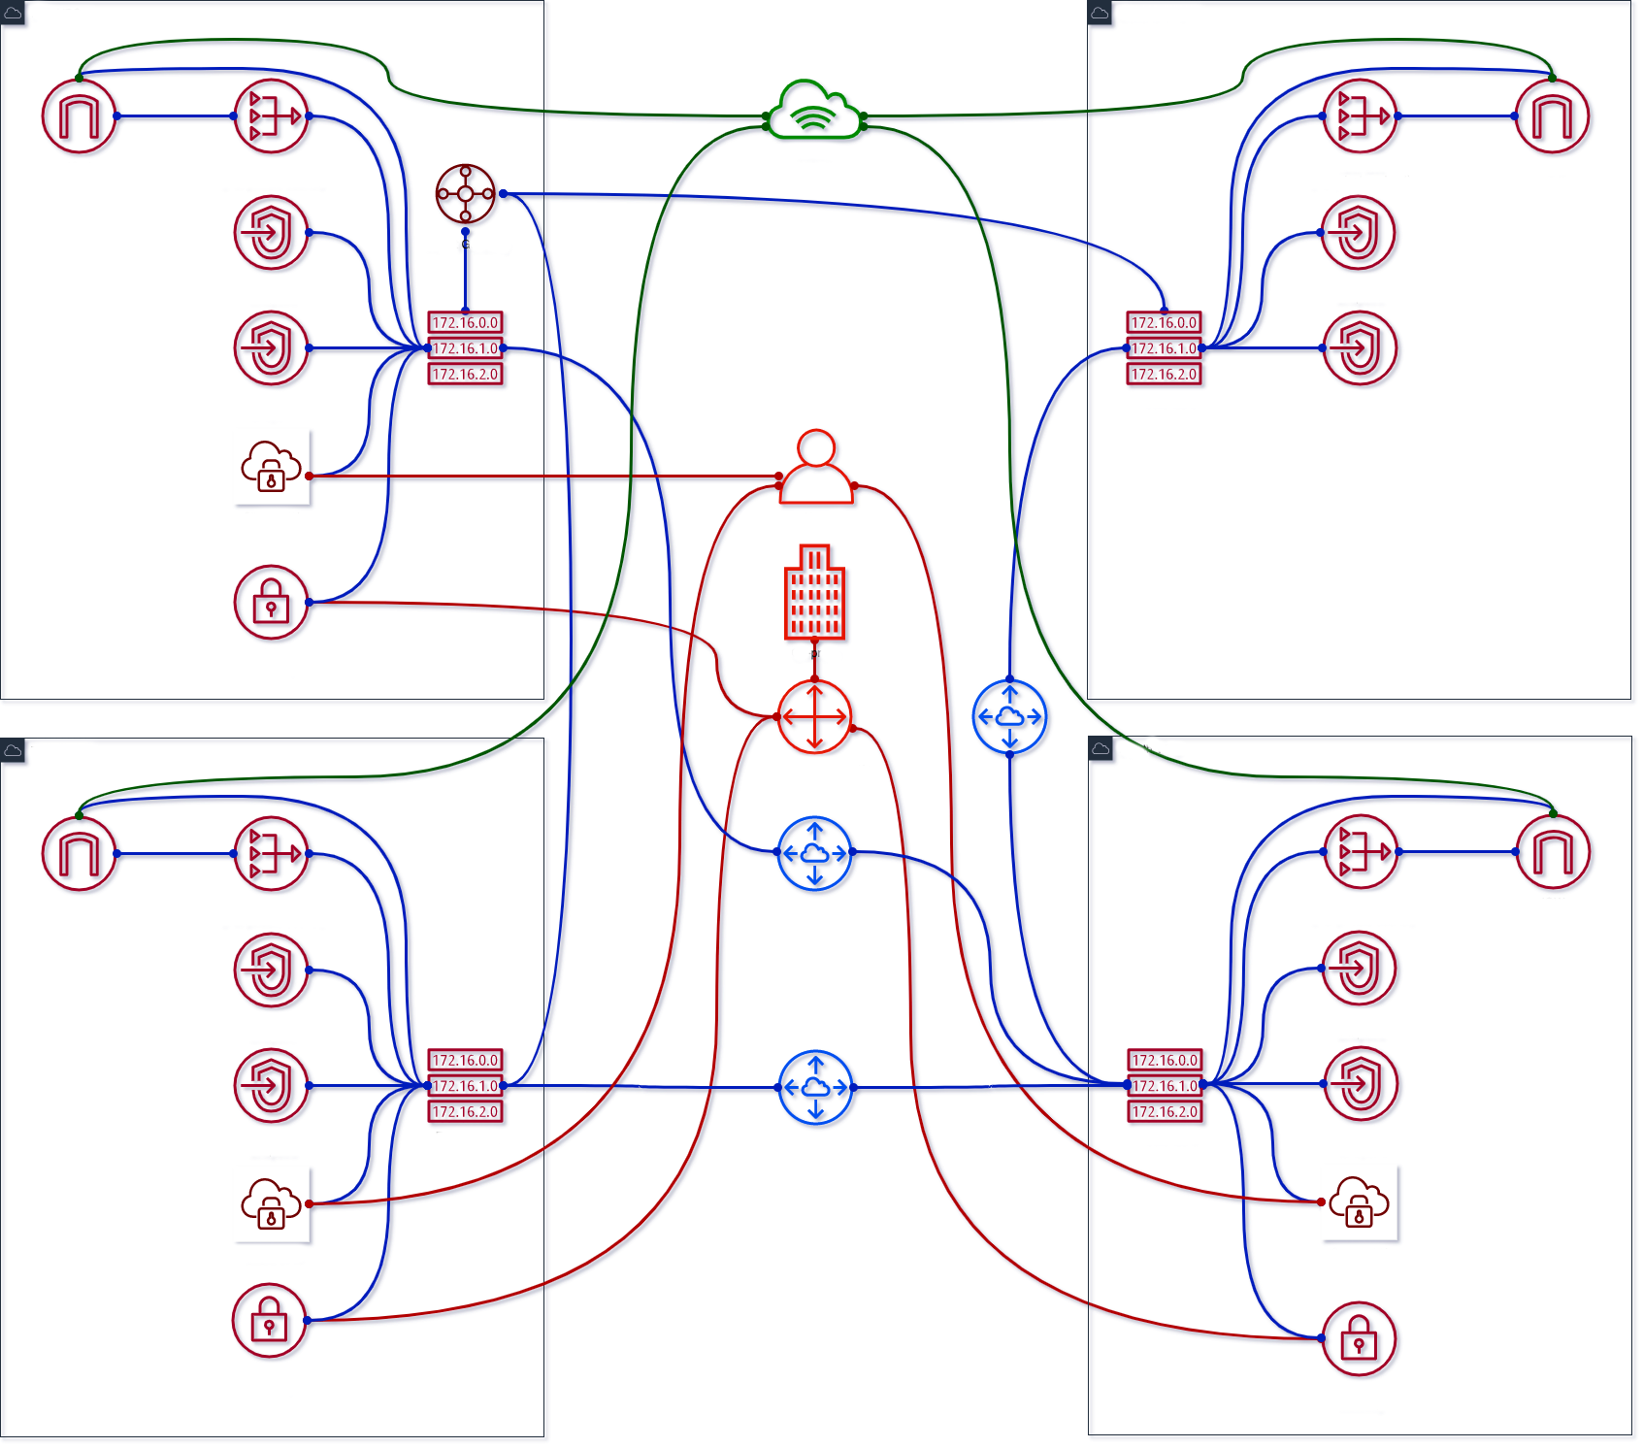
Destination | Private | Public | VPE
10.0.0.0/16 (VPC1) 10.1.0.0/16 (VPC2) 10.2.0.0/16 (VPC3) 10.3.0.0/16 (VPC4) | Local | Local | subnet-1a/b/c subnet-3a/b/c subnet-4a/b/c
0.0.0.0/0 | nat-1a/b/c… nat-2a/b/c… nat-3a/b/c… nat-4a/b/c… | igw-1… igw-2… igw-3… igw-4… | -
pl-… (S3) | vpc-1a/2a/3a/4a... | - | -
pl-… (DynDB) | vpc-1b/2b/3b/4b... | - | -
169.254.169.252 /30 (AWS) | - | - | subnet-1a/b/c subnet-3a/b/c subnet-4a/b/c
10.128.0.0/9 (Corp) | vgw-1… vgw-3… vgw-4… tgw-att-2/3... | vgw-1… vgw-3… vgw-4… tgw-att-2/3... | subnet-1a/b/c subnet-3a/b/c subnet-4a/b/c
10.0.0.0/16 (VPC1) | pcx-4… | pcx-4… | -
10.1.0.0/16 (VPC2) | pcx-4… | pcx-4… | -
10.2.0.0/16 (VPC3) | pcx-4... | pcx-4... | -
10.3.0.0/16 (VPC4) | pcx-1/2/3... | pcx-1/2/3... | -
10.0.0.0/9 (Cloud) | tgw-att-1/2/3... | tgw-att-1/2/3... | -
Resources | Costs
NAT GW | $420 + data
IGW | data
VPE | $765 + $12 (user) - $255
VGW | $108 - $36
TGW | $108 + data
Sum: | $1401 + $12/user + data
2020 / brainly.com
Notes:
Removed peering 1-3, 2-3
Prepare to remove VPNs for 3

Slide 29
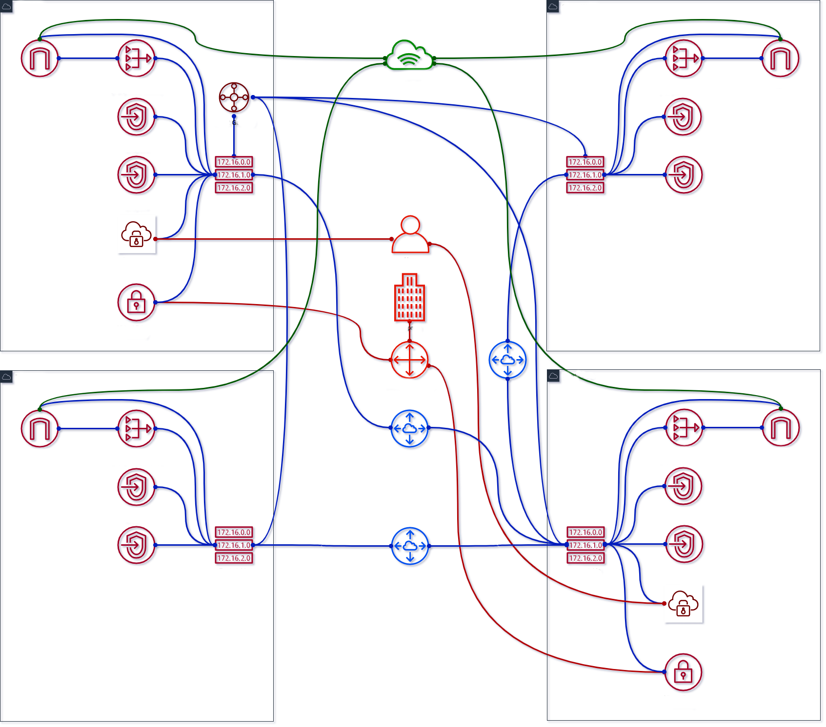
Destination | Private | Public | VPE
10.0.0.0/16 (VPC1) 10.1.0.0/16 (VPC2) 10.2.0.0/16 (VPC3) 10.3.0.0/16 (VPC4) | Local | Local | subnet-1a/b/c subnet-4a/b/c
0.0.0.0/0 | nat-1a/b/c… nat-2a/b/c… nat-3a/b/c… nat-4a/b/c… | igw-1… igw-2… igw-3… igw-4… | -
pl-… (S3) | vpc-1a/2a/3a/4a... | - | -
pl-… (DynDB) | vpc-1b/2b/3b/4b... | - | -
169.254.169.252 /30 (AWS) | - | - | subnet-1a/b/c subnet-4a/b/c
10.128.0.0/9 (Corp) | vgw-1… vgw-4… tgw-2/3... | vgw-1… vgw-4… tgw-2/3... | subnet-1a/b/c subnet-4a/b/c
10.0.0.0/16 (VPC1) | pcx-4… | pcx-4… | -
10.1.0.0/16 (VPC2) | pcx-4… | pcx-4… | -
10.2.0.0/16 (VPC3) | pcx-4... | pcx-4... | -
10.3.0.0/16 (VPC4) | pcx-1/2/3... | pcx-1/2/3... | -
10.0.0.0/9 (Cloud) | tgw-att-1/2/3/4... | tgw-att-1/2/3/4... | -
Resources | Costs
NAT GW | $420 + data
IGW | data
VPE | $510 + $12 (user)
VGW | $72
TGW | $108 + data + $36
Sum: | $1146 + $12/user + data
2020 / brainly.com
Notes:
Added TGW ATT for 4
Prepare to remove peering 1-4, 2-4, 3-4

Slide 30
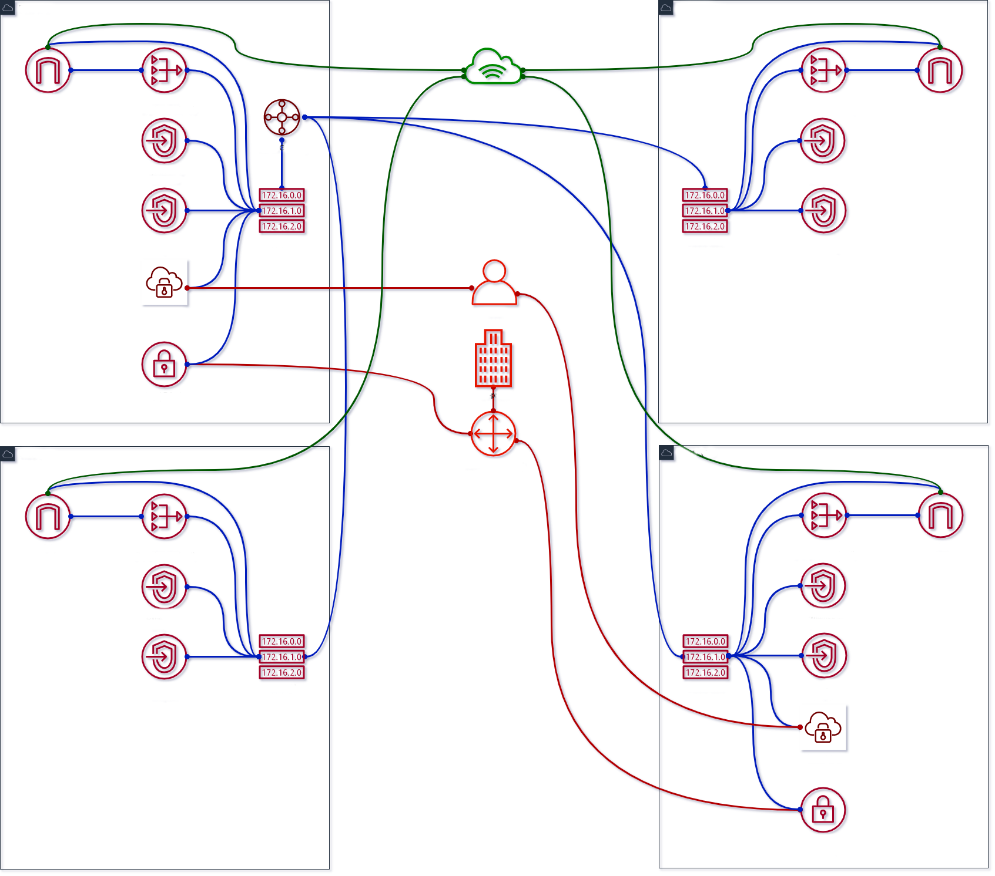
Destination | Private | Public | VPE
10.0.0.0/16 (VPC1) 10.1.0.0/16 (VPC2) 10.2.0.0/16 (VPC3) 10.3.0.0/16 (VPC4) | Local | Local | subnet-1a/b/c subnet-4a/b/c
0.0.0.0/0 | nat-1a/b/c… nat-2a/b/c… nat-3a/b/c… nat-4a/b/c… | igw-1… igw-2… igw-3… igw-4… | -
pl-… (S3) | vpc-1a/2a/3a/4a... | - | -
pl-… (DynDB) | vpc-1b/2b/3b/4b... | - | -
169.254.169.252 /30 (AWS) | - | - | subnet-1a/b/c subnet-4a/b/c
10.128.0.0/9 (Corp) | vgw-1… vgw-4… tgw-2/3/4... | vgw-1… vgw-4… tgw-2/3/4... | subnet-1a/b/c subnet-4a/b/c
10.0.0.0/16 (VPC1) | - | - | -
10.1.0.0/16 (VPC2) | - | - | -
10.2.0.0/16 (VPC3) | - | - | -
10.3.0.0/16 (VPC4) | - | - | -
10.0.0.0/9 (Cloud) | tgw-att-1/2/3/4... | tgw-att-1/2/3/4... | -
Resources | Costs
NAT GW | $420 + data
IGW | data
VPE | $510 + $12 (user) - $255
VGW | $72 - $36
TGW | $144 + data
Sum: | $1146 + $12/user + data
2020 / brainly.com
Notes:
Remove peering 1-4, 2-4, 3-4
Prepare to remove VPNs for 4, update routing for TGW

Slide 31
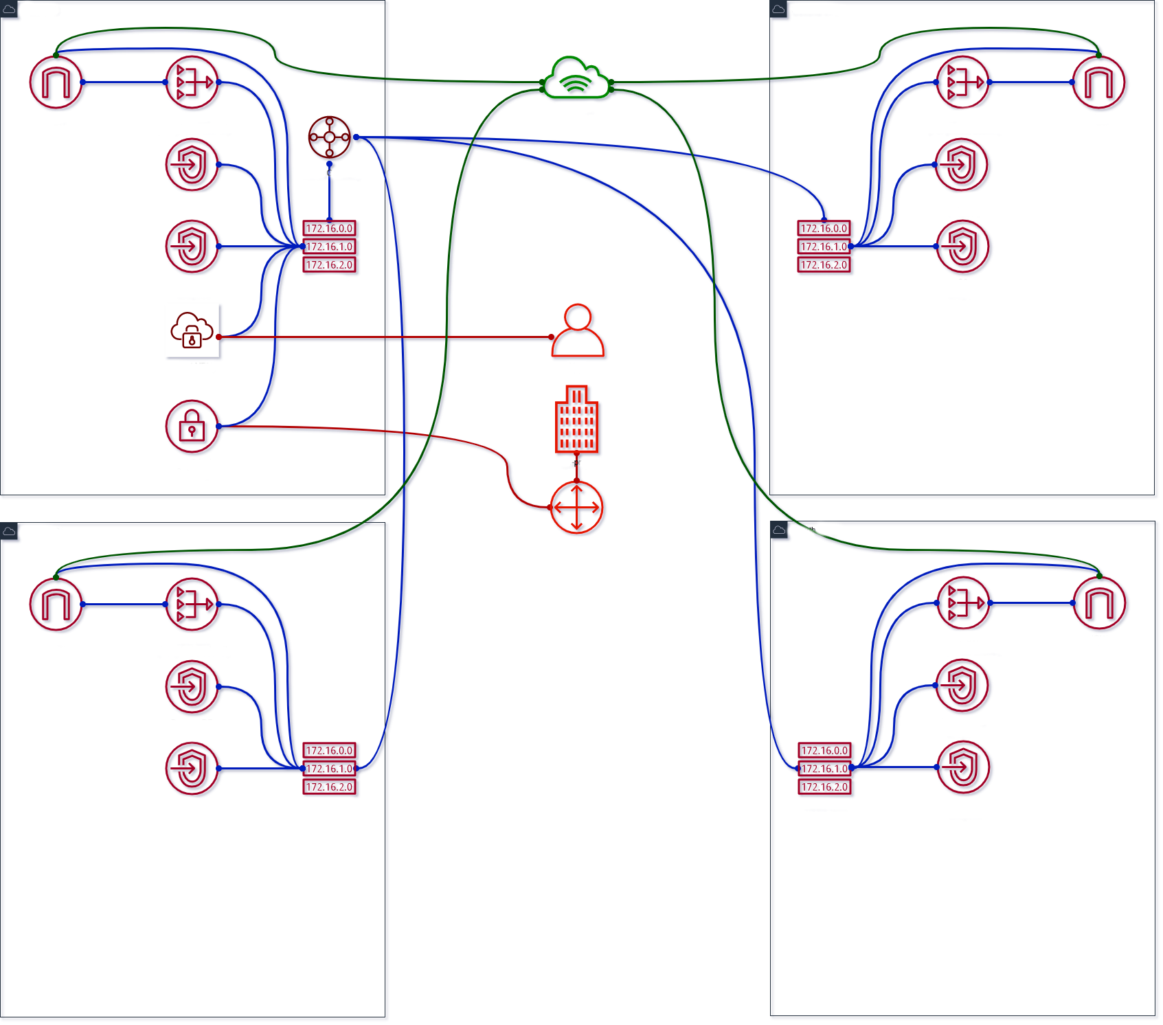
Destination | Private | Public | VPE
10.0.0.0/16 (VPC1) 10.1.0.0/16 (VPC2) 10.2.0.0/16 (VPC3) 10.3.0.0/16 (VPC4) | Local | Local | subnet-1a/b/c
0.0.0.0/0 | nat-1a/b/c… nat-2a/b/c… nat-3a/b/c… nat-4a/b/c… | igw-1… igw-2… igw-3… igw-4… | -
pl-… (S3) | vpc-1a/2a/3a/4a... | - | -
pl-… (DynDB) | vpc-1b/2b/3b/4b... | - | -
169.254.169.252 /30 (AWS) | - | - | subnet-1a/b/c
10.128.0.0/9 (Corp) | vgw-1… tgw-2/3/4... | vgw-1… tgw-2/3/4... | subnet-1a/b/c
10.0.0.0/16 (VPC1) | - | - | -
10.1.0.0/16 (VPC2) | - | - | -
10.2.0.0/16 (VPC3) | - | - | -
10.3.0.0/16 (VPC4) | - | - | -
10.0.0.0/9 (Cloud) | tgw-att-1/2/3/4... | tgw-att-1/2/3/4... | -
Resources | Costs
NAT GW | $420 + data
IGW | data
VPE | $255 + $12 (user)
VGW | $36
TGW | $144 + data
Sum: | $850 + $12/user + data
2020 / brainly.com
Notes:
Removed VPNs for 4 Compare to $1584 + $12/user + data with peering For 9 acc peering $3564, TGW is 105+36

Slide 32
Can we improve it?
Now lower costs even further
2020 / brainly.com

Slide 33
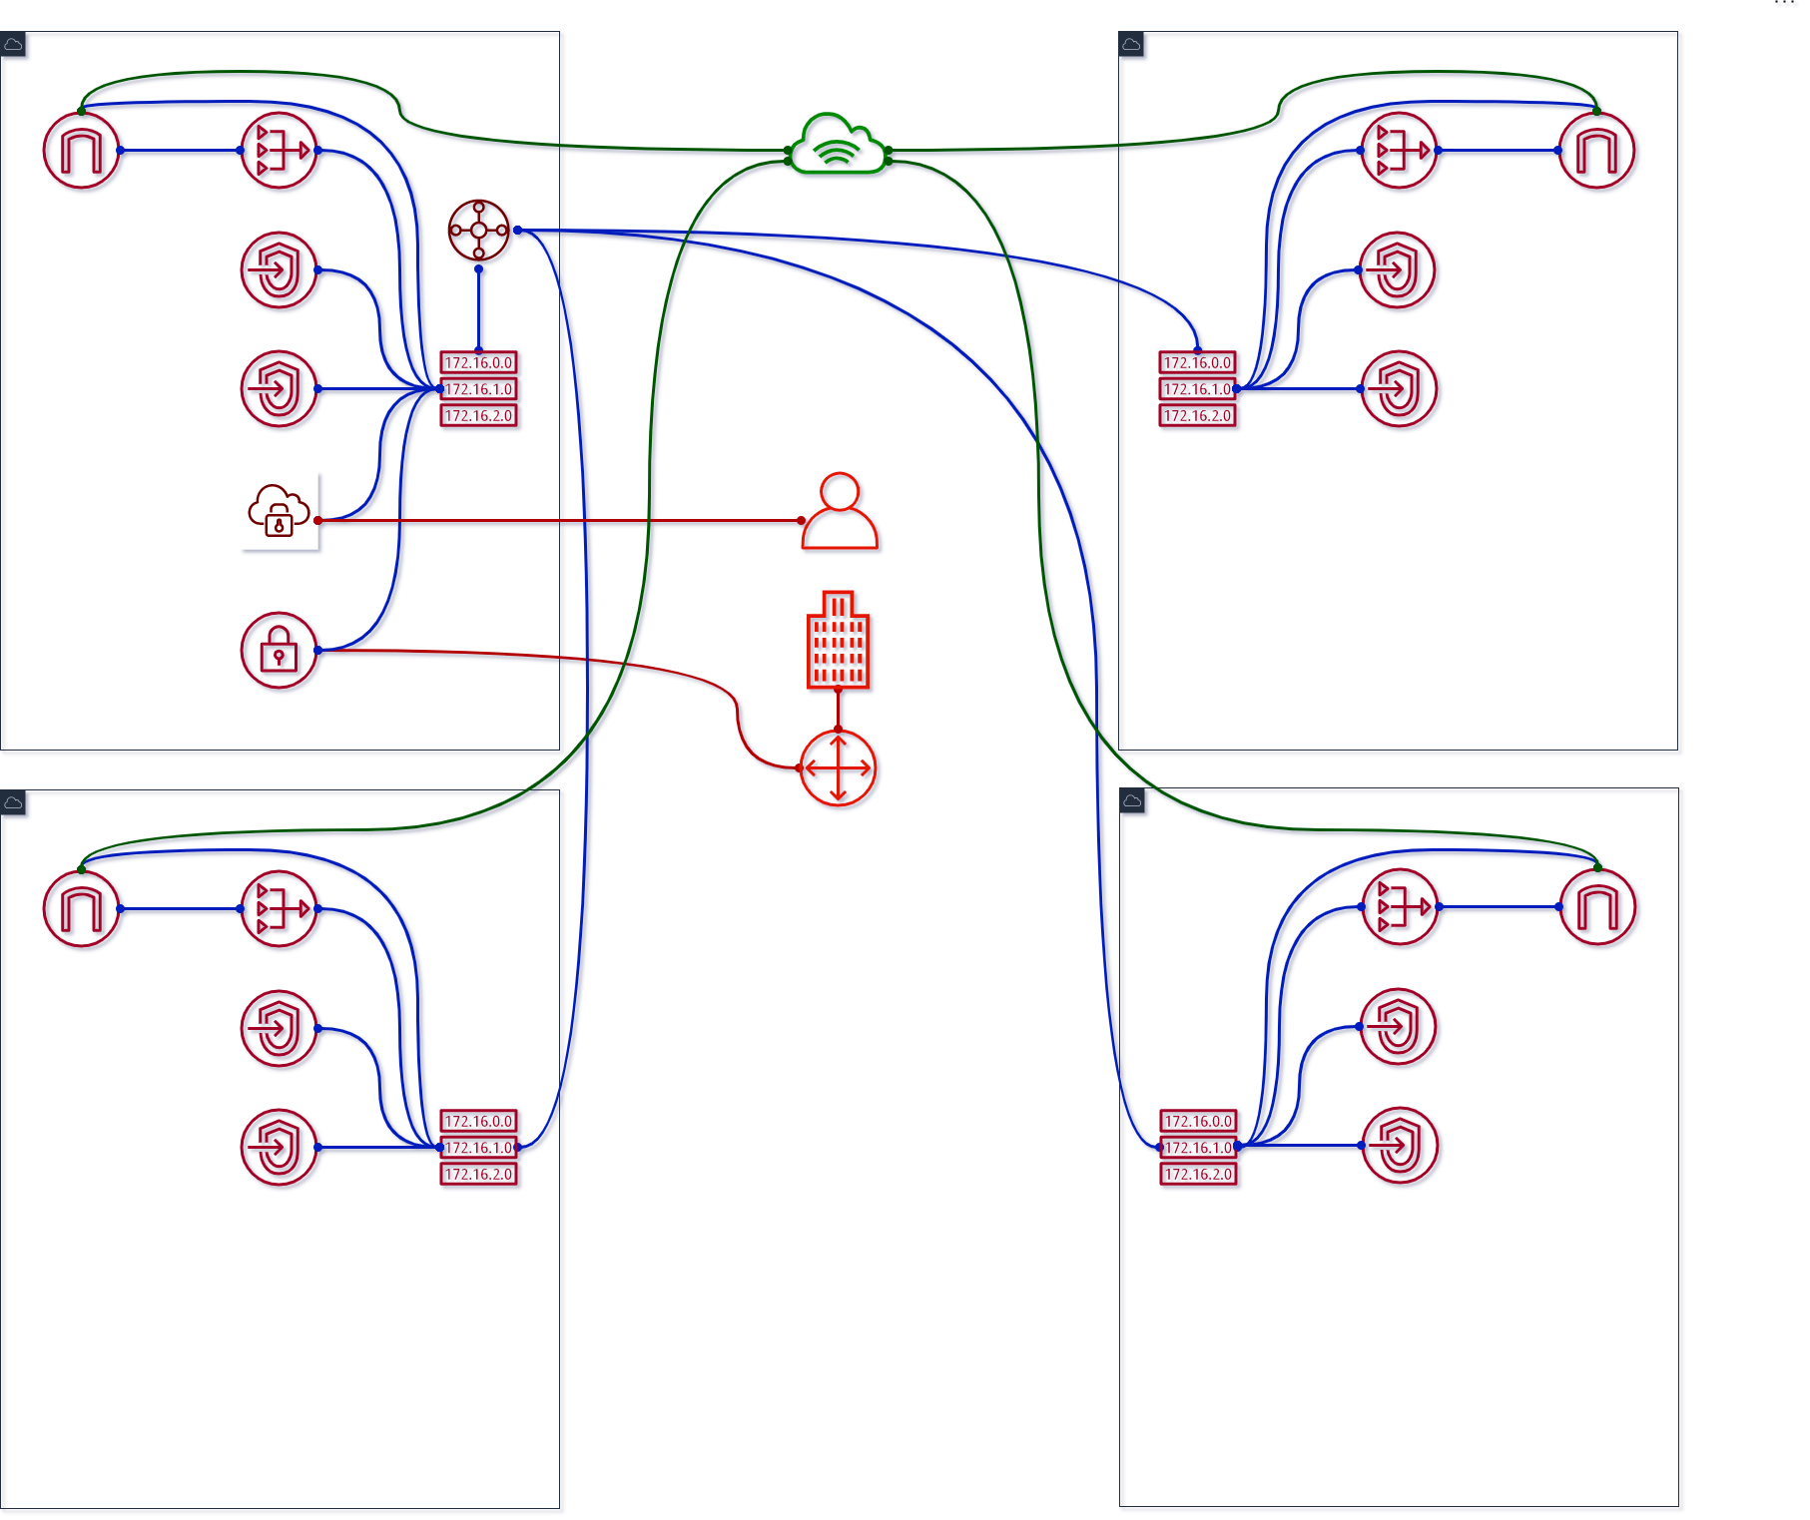
Destination | Private | Public | VPE
10.0.0.0/16 (VPC1) 10.1.0.0/16 (VPC2) 10.2.0.0/16 (VPC3) 10.3.0.0/16 (VPC4) | Local | Local | subnet-1a/b/c
0.0.0.0/0 | nat-1a/b/c… nat-2a/b/c… nat-3a/b/c… nat-4a/b/c… | igw-1… igw-2… igw-3… igw-4… | -
pl-… (S3) | vpc-1a/2a/3a/4a... | - | -
pl-… (DynDB) | vpc-1b/2b/3b/4b... | - | -
169.254.169.252 /30 (AWS) | - | - | subnet-1a/b/c
10.128.0.0/9 (Corp) | vgw-1… tgw-2/3/4... | vgw-1… tgw-2/3/4... | subnet-1a/b/c
10.0.0.0/16 (VPC1) | - | - | -
10.1.0.0/16 (VPC2) | - | - | -
10.2.0.0/16 (VPC3) | - | - | -
10.3.0.0/16 (VPC4) | - | - | -
10.0.0.0/9 (Cloud) | tgw-att-1/2/3/4... | tgw-att-1/2/3/4... | -
Resources | Costs
NAT GW | $420 + data - $315
IGW | data
VPE | $255 + $12 (user)
VGW | $36
TGW | $144 + data
Sum: | $850 + $12/user + data
2020 / brainly.com
Notes:
Prepare to remove NAT GW for 2, 3, 4

Slide 34
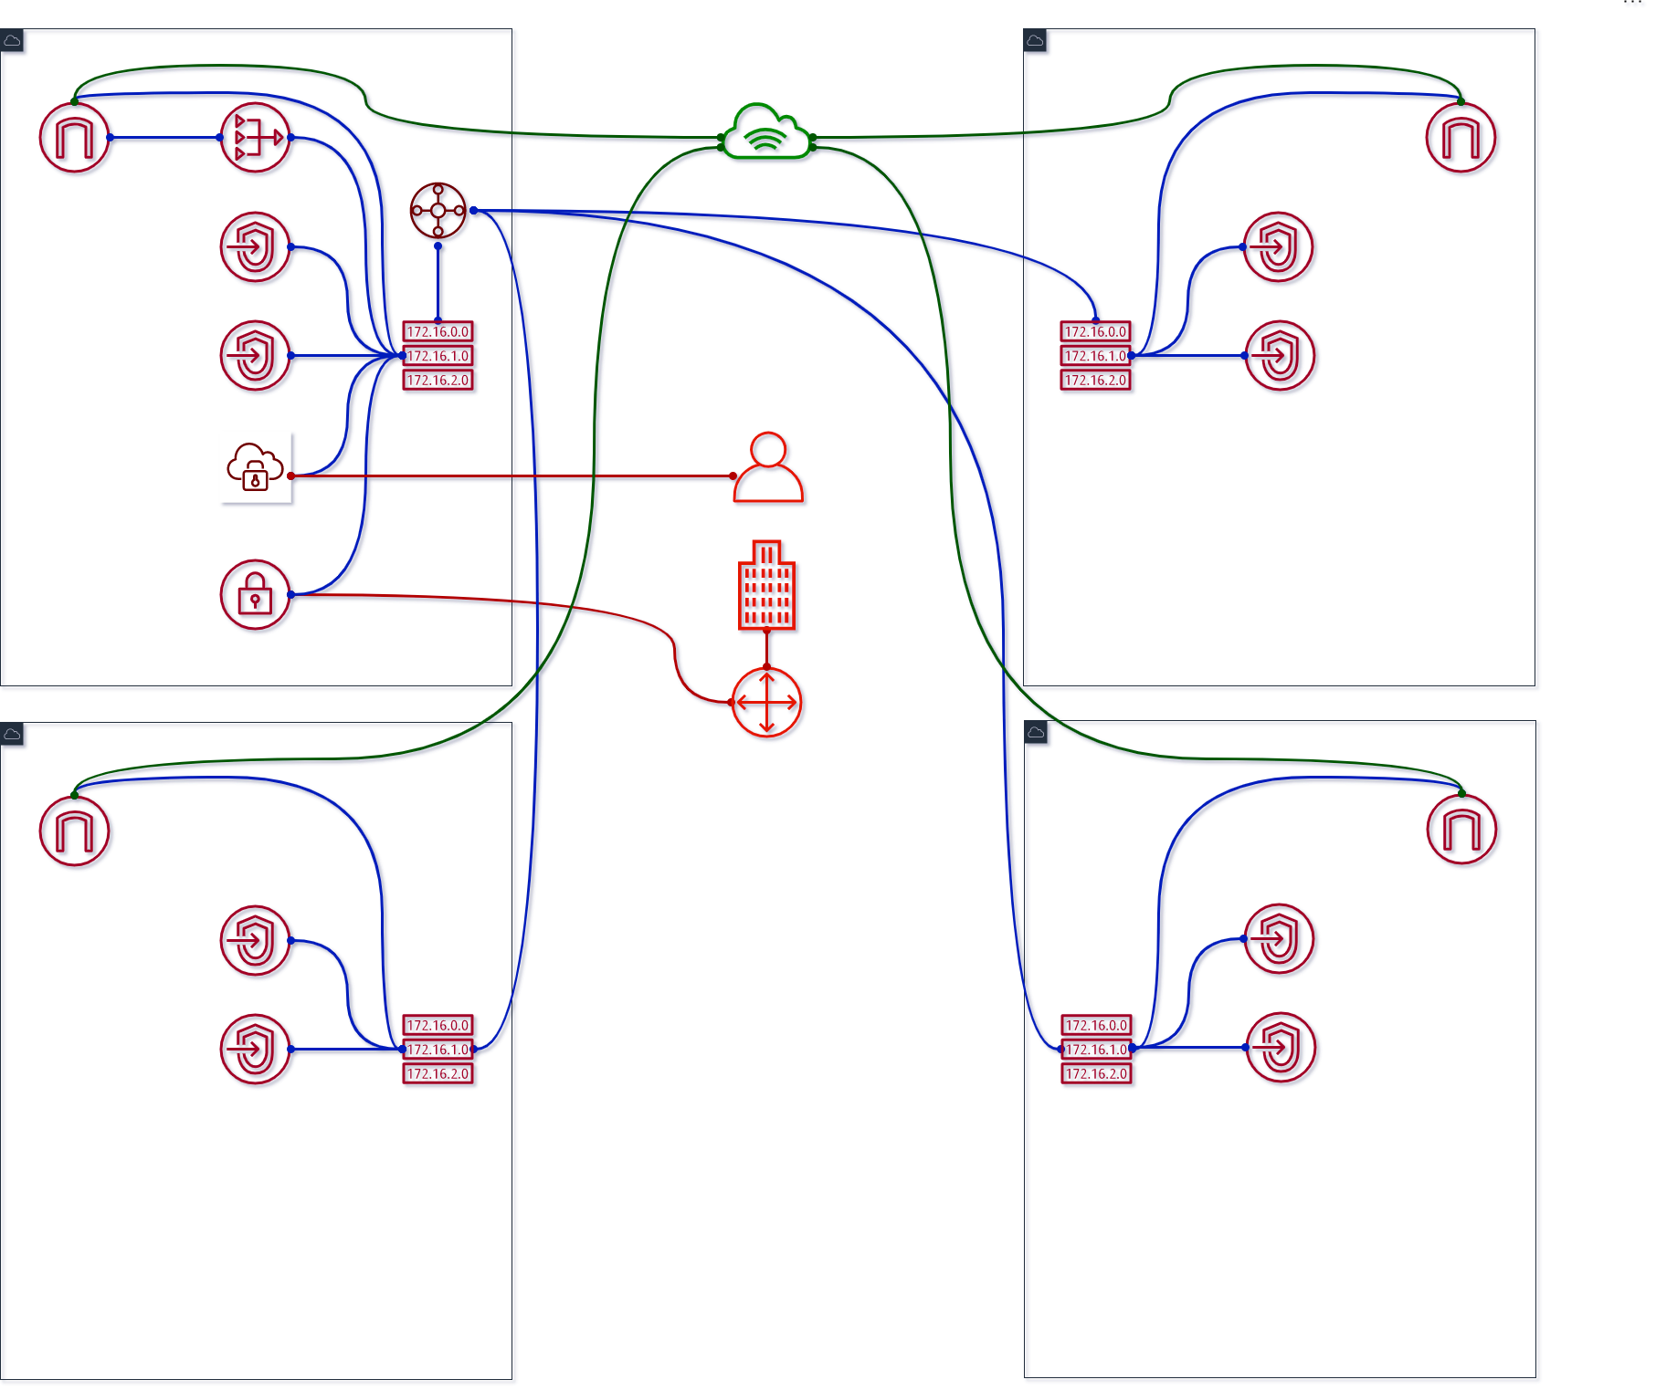
Destination | Private | Public | VPE
10.0.0.0/16 (VPC1) 10.1.0.0/16 (VPC2) 10.2.0.0/16 (VPC3) 10.3.0.0/16 (VPC4) | Local | Local | subnet-1a/b/c
0.0.0.0/0 | nat-1a/b/c… | igw-1… igw-2… igw-3… igw-4… | -
pl-… (S3) | vpc-1a/2a/3a/4a... | - | -
pl-… (DynDB) | vpc-1b/2b/3b/4b... | - | -
169.254.169.252 /30 (AWS) | - | - | subnet-1a/b/c
10.128.0.0/9 (Corp) | vgw-1… tgw-2/3/4... | vgw-1… tgw-2/3/4... | subnet-1a/b/c
10.0.0.0/16 (VPC1) | - | - | -
10.1.0.0/16 (VPC2) | - | - | -
10.2.0.0/16 (VPC3) | - | - | -
10.3.0.0/16 (VPC4) | - | - | -
10.0.0.0/9 (Cloud) | tgw-att-1/2/3/4... | tgw-att-1/2/3/4... | -
Resources | Costs
NAT GW | $105 + data
IGW | data
VPE | $255 + $12 (user)
VGW | $36
TGW | $144 + data
Sum: | $540 + $12/user + data
2020 / brainly.com
Notes:
Removed NAT GWs, prepare to remove IGWs for 2, 3, 4

Slide 35
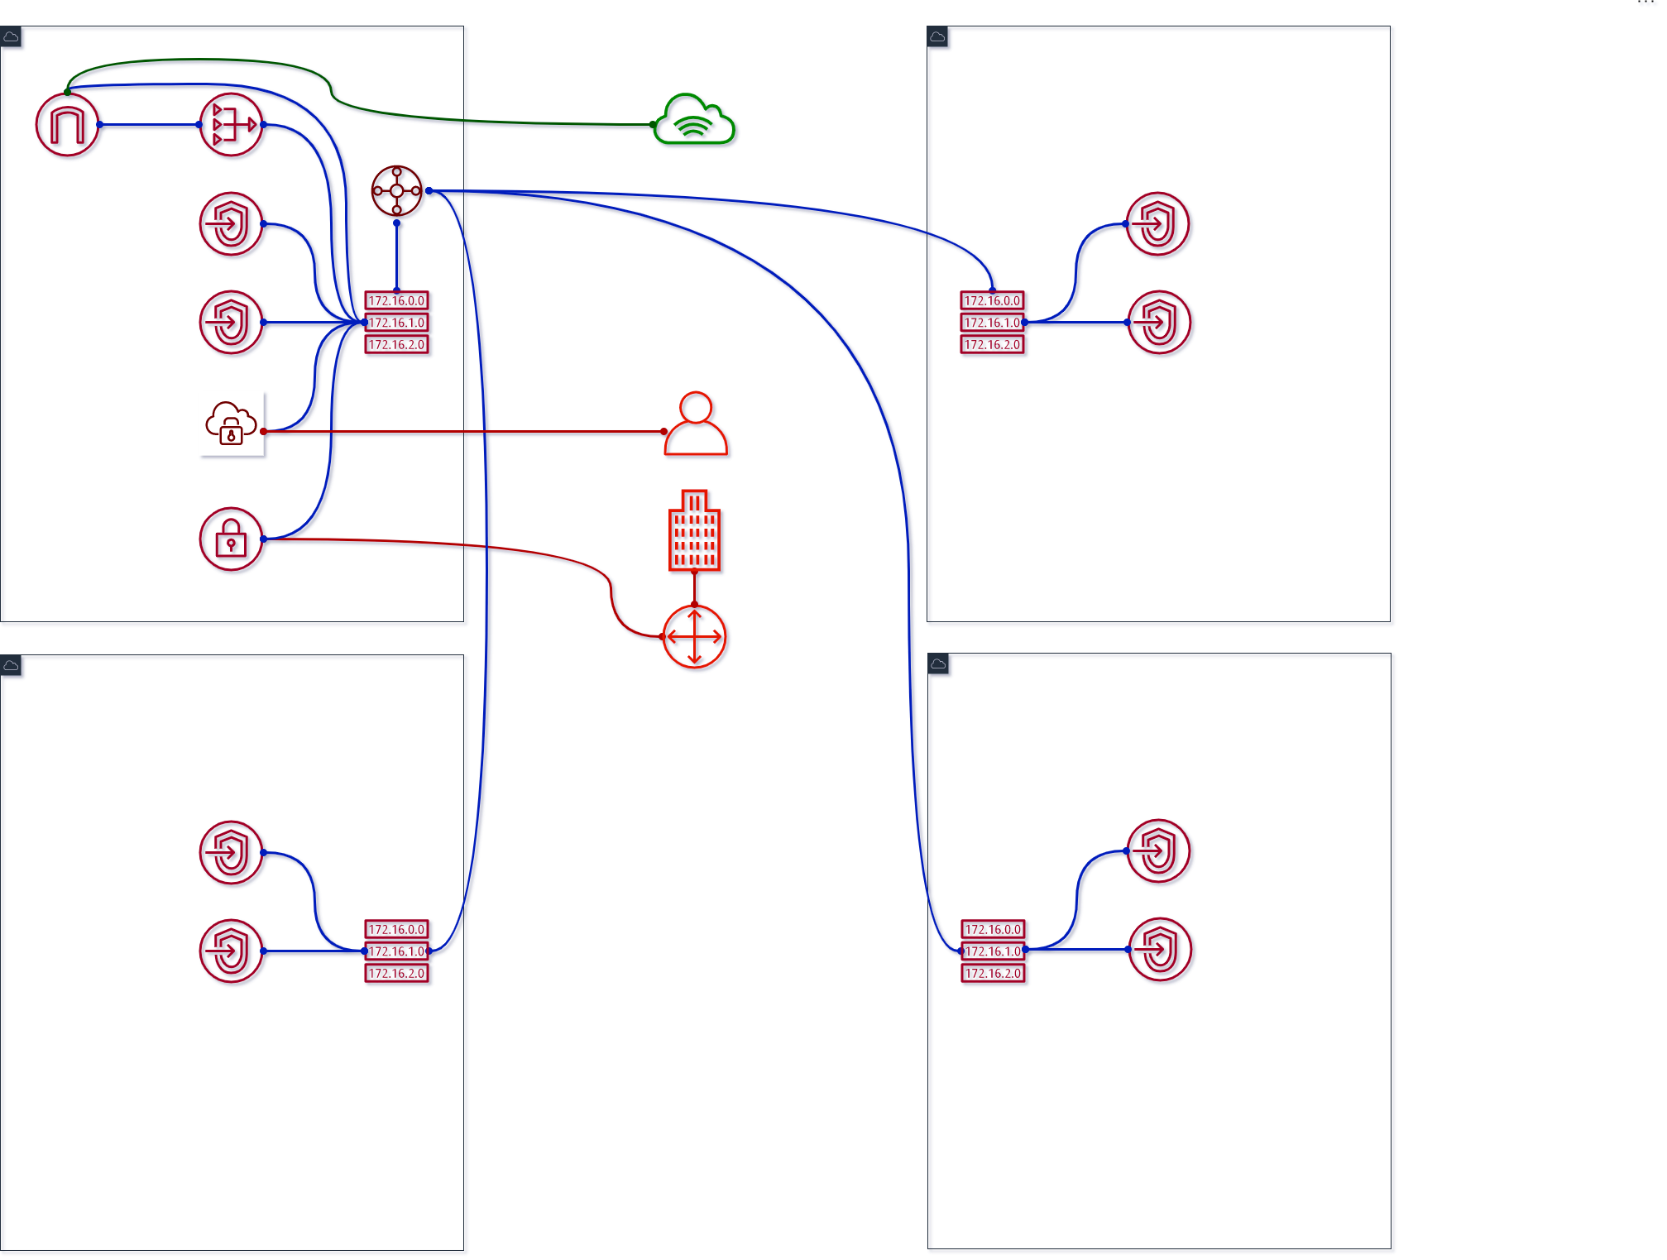
Destination | Private | Public | VPE
10.0.0.0/16 (VPC1) 10.1.0.0/16 (VPC2) 10.2.0.0/16 (VPC3) 10.3.0.0/16 (VPC4) | Local | Local | subnet-1a/b/c
0.0.0.0/0 | nat-1a/b/c… | igw-1… | -
pl-… (S3) | vpc-1a/2a/3a/4a... | - | -
pl-… (DynDB) | vpc-1b/2b/3b/4b... | - | -
169.254.169.252 /30 (AWS) | - | - | subnet-1a/b/c
10.128.0.0/9 (Corp) | vgw-1… tgw-2/3/4... | vgw-1… tgw-2/3/4... | subnet-1a/b/c
10.0.0.0/16 (VPC1) | - | - | -
10.1.0.0/16 (VPC2) | - | - | -
10.2.0.0/16 (VPC3) | - | - | -
10.3.0.0/16 (VPC4) | - | - | -
10.0.0.0/9 (Cloud) | tgw-att-1/2/3/4... | tgw-att-1/2/3/4... | -
Resources | Costs
NAT GW | $105 + data
IGW | data
VPE | $255 + $12 (user)
VGW | $36
TGW | $144 + data
Sum: | $540 + $12/user + data
2020 / brainly.com
Notes:
Removed IGWs
Prepare to remove VGW from subnets’ RTs

Slide 36
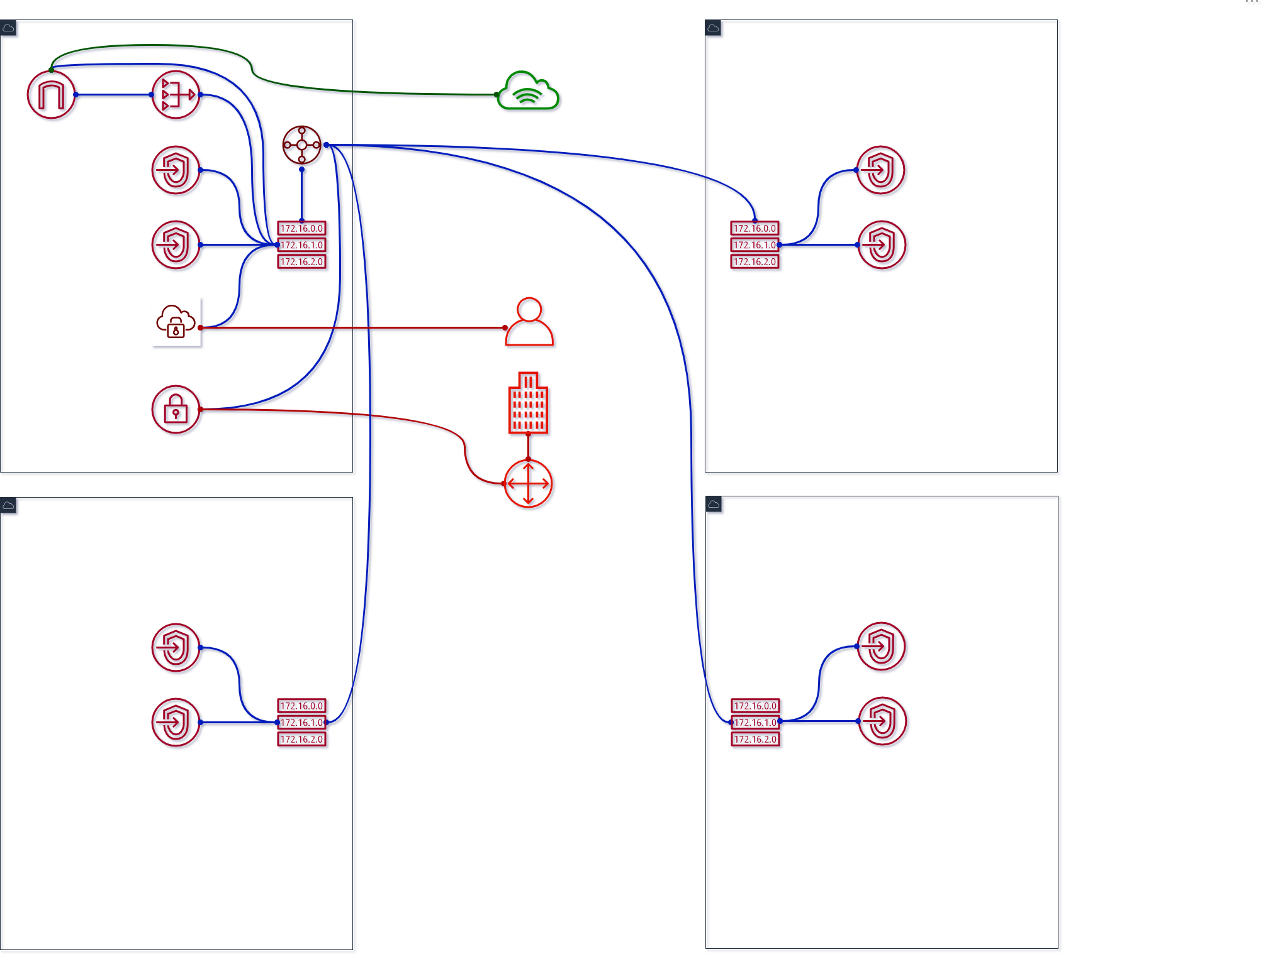
Destination | Private | Public | VPE
10.0.0.0/16 (VPC1) 10.1.0.0/16 (VPC2) 10.2.0.0/16 (VPC3) 10.3.0.0/16 (VPC4) | Local | Local | subnet-1a/b/c
0.0.0.0/0 | nat-1a/b/c… | igw-1… | -
pl-… (S3) | vpc-1a/2a/3a/4a... | - | -
pl-… (DynDB) | vpc-1b/2b/3b/4b... | - | -
169.254.169.252 /30 (AWS) | - | - | subnet-1a/b/c
10.128.0.0/9 (Corp) | tgw-1/2/3/4... | tgw-1/2/3/4... | subnet-1a/b/c
10.0.0.0/16 (VPC1) | - | - | -
10.1.0.0/16 (VPC2) | - | - | -
10.2.0.0/16 (VPC3) | - | - | -
10.3.0.0/16 (VPC4) | - | - | -
10.0.0.0/9 (Cloud) | tgw-att-1/2/3/4... | tgw-att-1/2/3/4... | -
Resources | Costs
NAT GW | $105 + data
IGW | data
VPE | $255 + $12 (user)
VGW | $36
TGW | $144 + $36 + data
Sum: | $576 + $12/user + data
2020 / brainly.com
Notes:
Added VPN TGW attachment Set in TGW RT, not in VPC RT per each subnet

Slide 37
What is the limit?
And mirror everything in another region
2020 / brainly.com

Slide 38
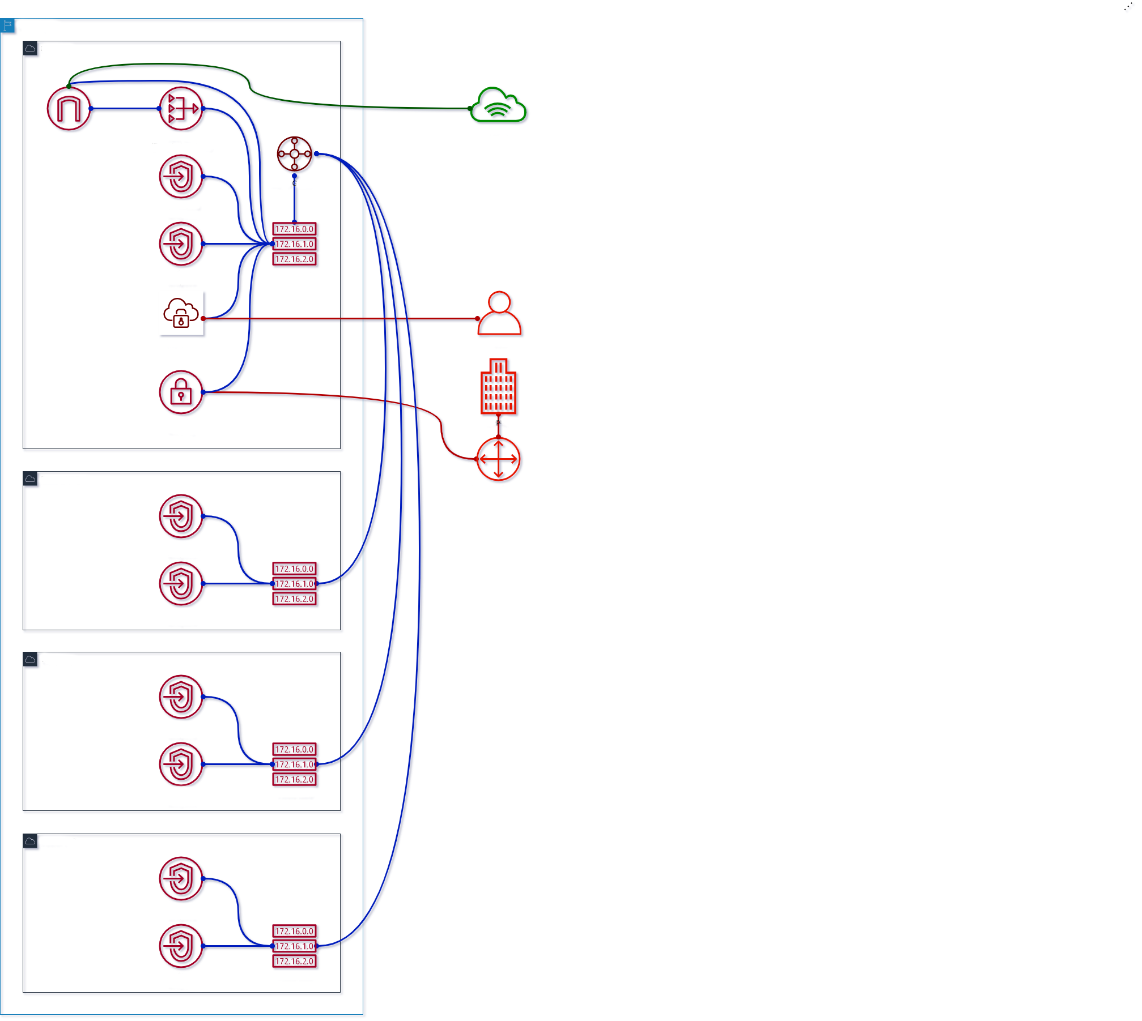
Destination | Private | Public | VPE
10.0.0.0/16 (VPC1) 10.1.0.0/16 (VPC2) 10.2.0.0/16 (VPC3) 10.3.0.0/16 (VPC4) | Local | Local | subnet-1a/b/c
0.0.0.0/0 | nat-1a/b/c… | igw-1… | -
pl-… (S3) | vpc-1a/2a/3a/4a... | - | -
pl-… (DynDB) | vpc-1b/2b/3b/4b... | - | -
169.254.169.252 /30 (AWS) | - | - | subnet-1a/b/c
10.128.0.0/9 (Corp) | vgw-1… tgw-2/3/4... | vgw-1… tgw-2/3/4... | subnet-1a/b/c
10.0.0.0/13 (1st Region) | tgw-att-1/2/3/4... | tgw-att-1/2/3/4... | -
10.5.0.0/13 (2nd Region) | - | - | -
Resources | Costs
NAT GW | $105 + data
IGW | data
VPE | $255 + $12 (user)
VGW | $36
TGW | $180 + data
Sum: | $576 + $12/user + data
2020 / brainly.com
Notes:
Move around

Slide 39
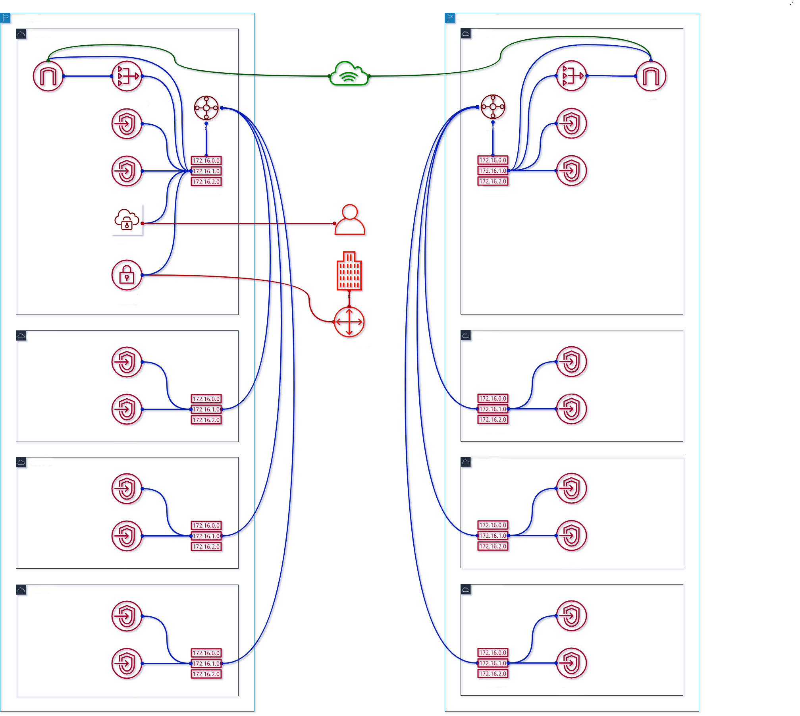
Destination | Private | Public | VPE
10.0.0.0/16 (VPC1) 10.1.0.0/16 (VPC2) 10.2.0.0/16 (VPC3) 10.3.0.0/16 (VPC4) 10.4.0.0/16(VPC5) 10.5.0.0/16(VPC6) 10.6.0.0/16(VPC7) 10.7.0.0/16(VPC8) | Local | Local | subnet-1a/b/c
0.0.0.0/0 | nat-1a/b/c… nat-5a/b/c... | igw-1… igw-5... | -
pl-… (S3) | vpc-1a/2a/3a/4a /5a/6a/7a/8a... | - | -
pl-… (DynDB) | vpc-1b/2b/3b/4b /5b/6b/7b/8b... | - | -
169.254.169.252 /30 (AWS) | - | - | subnet-1a/b/c
10.128.0.0/9 (Corp) | vgw-1… tgw-2/3/4... | vgw-1… tgw-2/3/4... | subnet-1a/b/c
10.0.0.0/13 (1st Region) | tgw-att-1/2/3/4... | tgw-att-1/2/3/4... | -
10.5.0.0/13 (2nd Region) | tgw-att-5/6/7/8... | tgw-att-5/6/7/8... | -
Resources | Costs
NAT GW | $105 + data + $105
IGW | data
VPE | $255 + $12 (user)
VGW | $36
TGW | $180 + data + $144
Sum: | $861 + $12/user + data
2020 / brainly.com
Notes:
Create VPs in other region

Slide 40
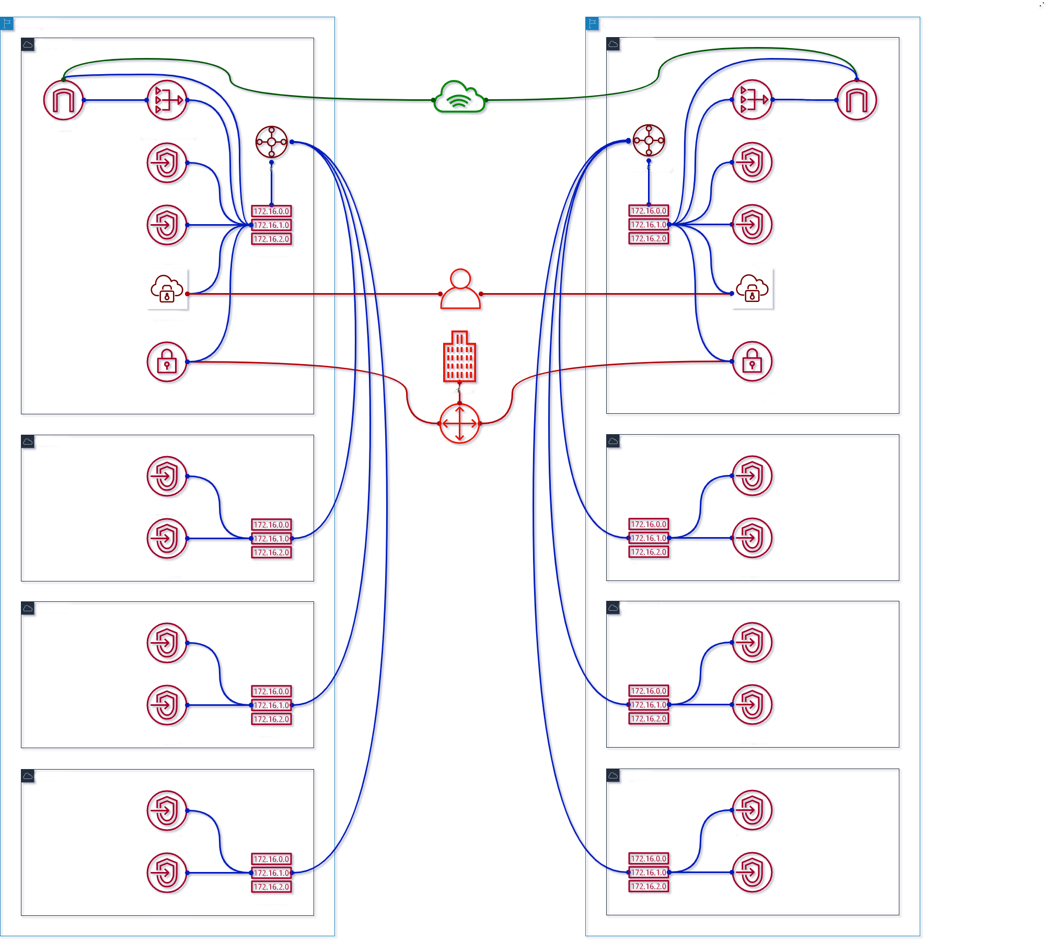
Destination | Private | Public | VPE
10.0.0.0/16 (VPC1) 10.1.0.0/16 (VPC2) 10.2.0.0/16 (VPC3) 10.3.0.0/16 (VPC4) 10.4.0.0/16(VPC5) 10.5.0.0/16(VPC6) 10.6.0.0/16(VPC7) 10.7.0.0/16(VPC8) | Local | Local | subnet-1a/b/c subnet-5a/b/c
0.0.0.0/0 | nat-1a/b/c… nat-5a/b/c... | igw-1… igw-5... | -
pl-… (S3) | vpc-1a/2a/3a/4a /5a/6a/7a/8a... | - | -
pl-… (DynDB) | vpc-1b/2b/3b/4b /5b/6b/7b/8b... | - | -
169.254.169.252 /30 (AWS) | - | - | subnet-1a/b/c subnet-5a/b/c
10.128.0.0/9 (Corp) | vgw-1/5… tgw-2/3/4/6/7/8... | vgw-1/5… tgw-2/3/4/6/7/8... | subnet-1a/b/c subnet-5a/b/c
10.0.0.0/13 (1st Region) | tgw-att-1/2/3/4... | tgw-att-1/2/3/4... | -
10.5.0.0/13 (2nd Region) | tgw-att-5/6/7/8... | tgw-att-5/6/7/8... | -
Resources | Costs
NAT GW | $210 + data
IGW | data
VPE | $510 + $12 (user)
VGW | $72
TGW | $324 + data
Sum: | $1116 + $12/user + data
2020 / brainly.com
Notes:
Add VPNs for second region

Slide 41
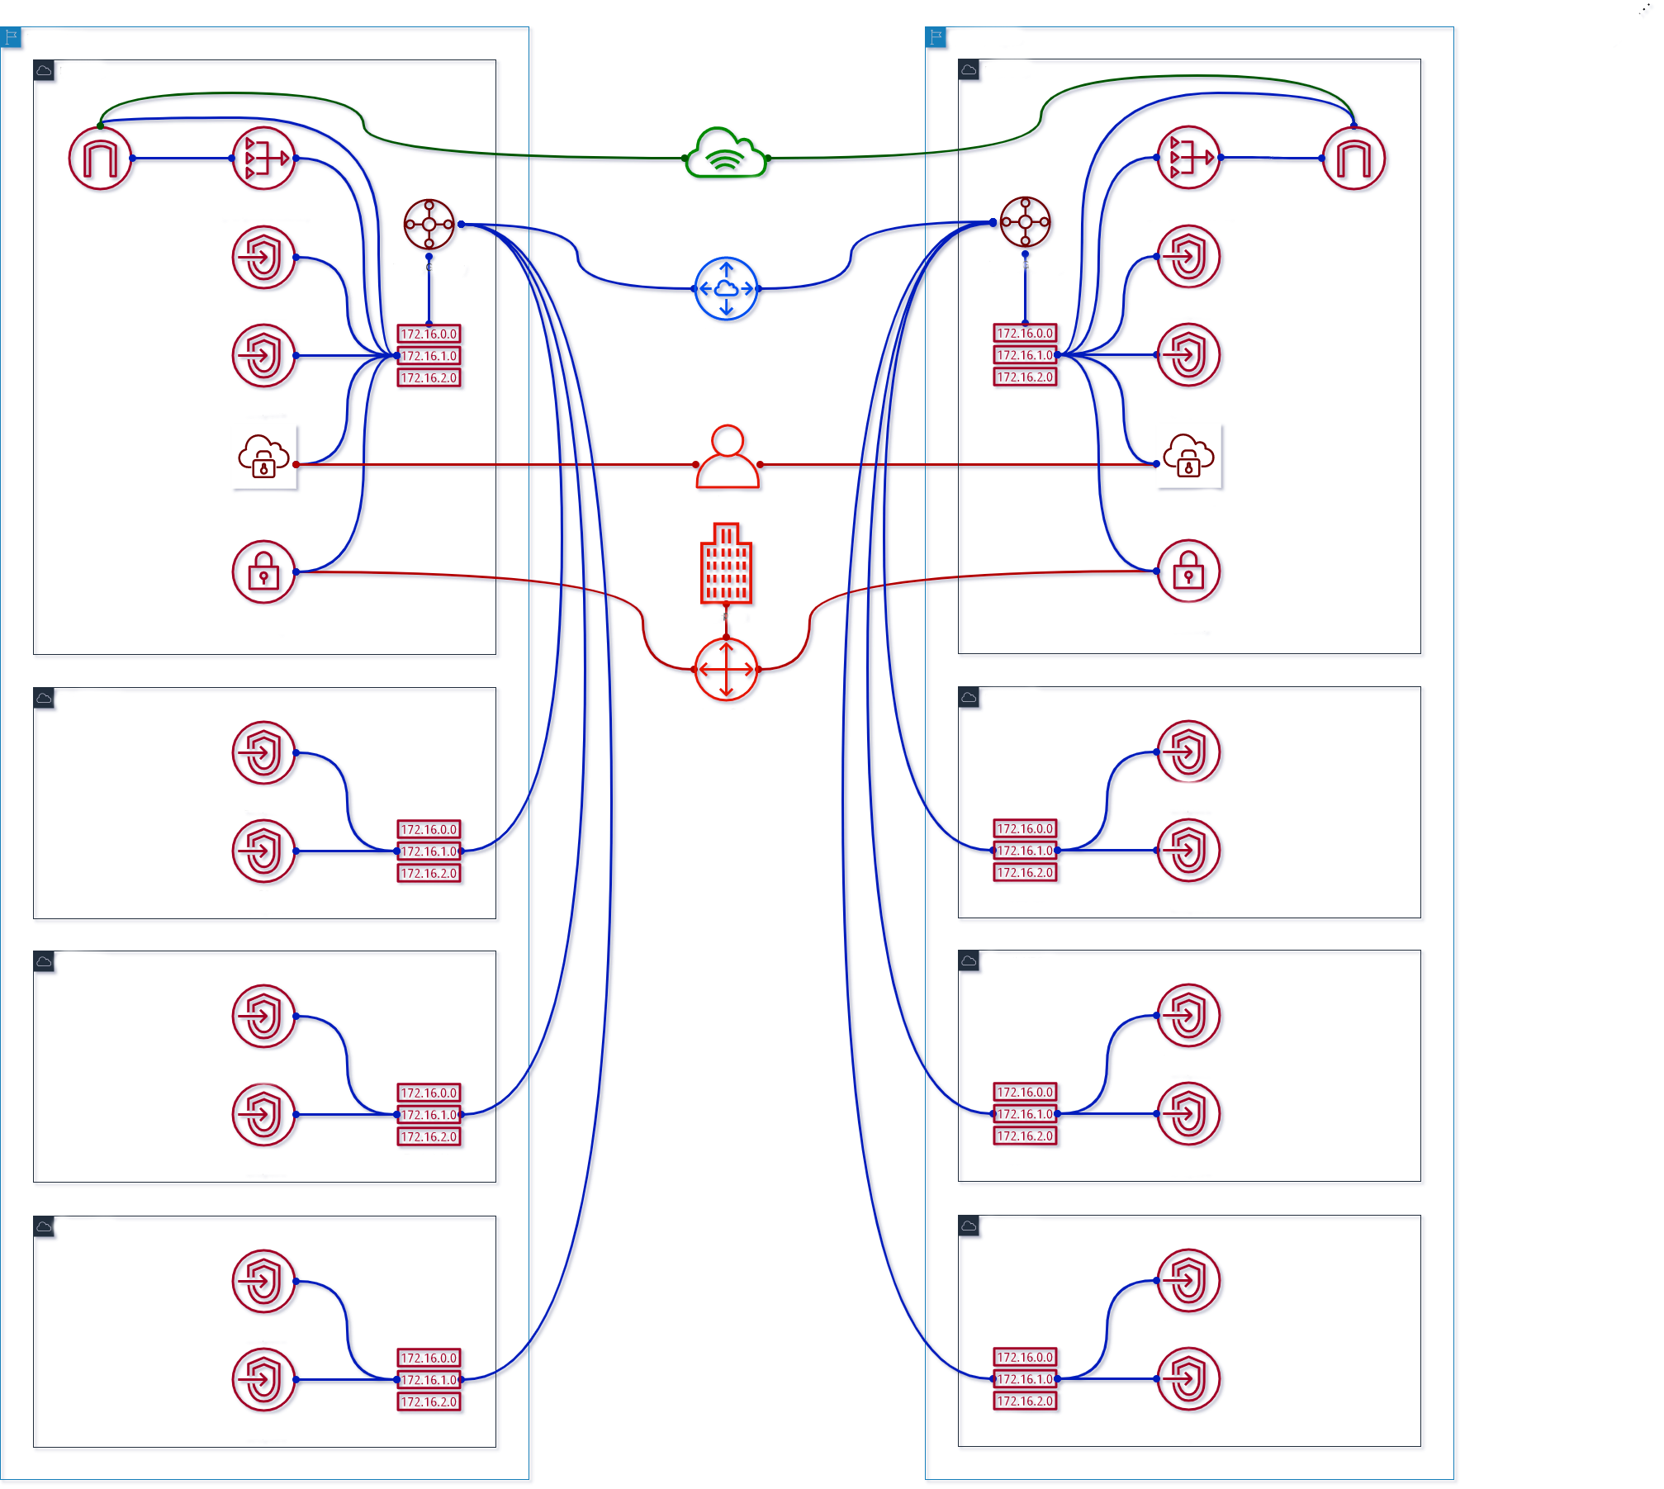
Destination | Private | Public | VPE
10.0.0.0/16 (VPC1) 10.1.0.0/16 (VPC2) 10.2.0.0/16 (VPC3) 10.3.0.0/16 (VPC4) 10.4.0.0/16(VPC5) 10.5.0.0/16(VPC6) 10.6.0.0/16(VPC7) 10.7.0.0/16(VPC8) | Local | Local | subnet-1a/b/c subnet-5a/b/c
0.0.0.0/0 | nat-1a/b/c… nat-5a/b/c... | igw-1… igw-5... | -
pl-… (S3) | vpc-1a/2a/3a/4a /5a/6a/7a/8a... | - | -
pl-… (DynDB) | vpc-1b/2b/3b/4b /5b/6b/7b/8b... | - | -
169.254.169.252 /30 (AWS) | - | - | subnet-1a/b/c subnet-5a/b/c
10.128.0.0/9 (Corp) | vgw-1/5… tgw-2/3/4/6/7/8... | vgw-1/5… tgw-2/3/4/6/7/8... | subnet-1a/b/c subnet-5a/b/c
10.0.0.0/13 (1st Region) | tgw-att-1/2/3/4... pcx-5... | tgw-att-1/2/3/4... pcx-5... | -
10.5.0.0/13 (2nd Region) | tgw-att-5/6/7/8... pcx-1... | tgw-att-5/6/7/8... pcx-1... | -
Resources | Costs
NAT GW | $210 + data
IGW | data
VPE | $510 + $12 (user)
VGW | $72
TGW | $423 + data
Sum: | $1116 + $12/user + data
2020 / brainly.com
Notes:
Add peering between regions Around $540 per each region

Slide 42
SUMMARY COMPARISON
Accounts | Peering | Transit Gateway | Transit Gateway + Egress
1 | $396 | $432 | $432
2 | $792 (+396) | $573 (+141) | $468 (+36)
3 | $1’188 (+396) | $714 (+141) | $504 (+36)
4 | $1’584 (+396) | $855 (+141) | $540 (+36)
9 | $3’564 (+1980) | $1’560 (+705) | $720 (+180)
15 | $5’940 (+2376) | $2’406 (+846) | $936 (+216)
100 | - | $14’391 (+11985) | $3’996 (+3060)
2020 / brainly.com
Notes:
Up to 50-125 peerings -> 9 to 15 VPCs at most

Slide 43
CONNECTING COUPLE OF VPCS VPC PEERING
Up to 9 VPCs or 15 if requested limit increase on peering (50-125)
2020 / brainly.com
Notes:
Up to 50-125 peerings -> 9 to 15 VPCs at most

Slide 44
CONNECTING MANY VPCS TRANSIT GATEWAY
Up to 5000 attachments
20 route tables (routing domain) per Transit Gateway
2020 / brainly.com

Slide 45
CONNECTING MULTIPLE REGIONS AND MANY VPCS VPC PEERING + TRANSIT GATEWAY
2020 / brainly.com

Slide 46
THANK YOU
Krzysztof Szyper
Managing networking chaos while migrating to AWS multi-account architecture

